Slide 1

oRCAle World
Root Cause Analysis
Daniel A. Morgan: Oracle ACE Director

Slide 2


Daniel Morgan
More than 45 years technology experience
  First computer was an IBM 360/40 mainframe in 1970
  Fortran IV and Punch Cards
Oracle ACE Director
Curriculum author and primary Oracle instructor at University of Washington
Guest lecturer on Oracle at Harvard University
Decades of hands-on SQL, PL/SQL, and DBA experience
The "Morgan" behind Morgan's Library on the web
www.morganslibrary.org
10g, 11g, and 12c Beta tester
Co-founder International GoldenGate Oracle Users Group

Slide 3
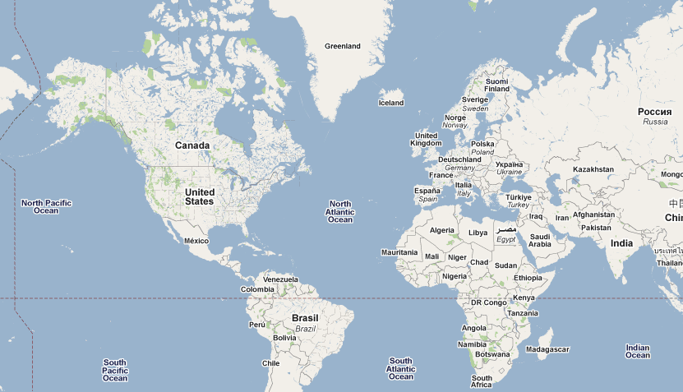
cd $MORGAN_BASE

Slide 4
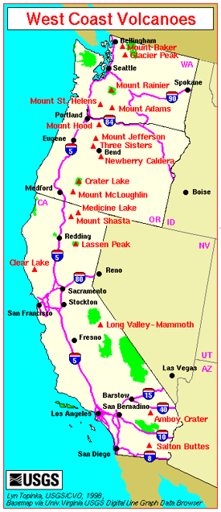
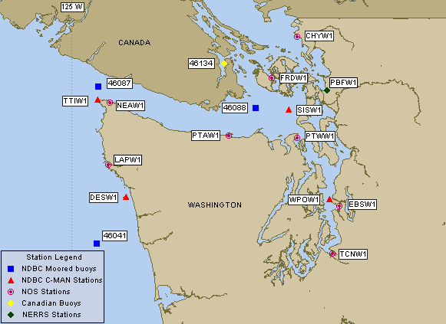
cd $MORGAN_HOME

Slide 5
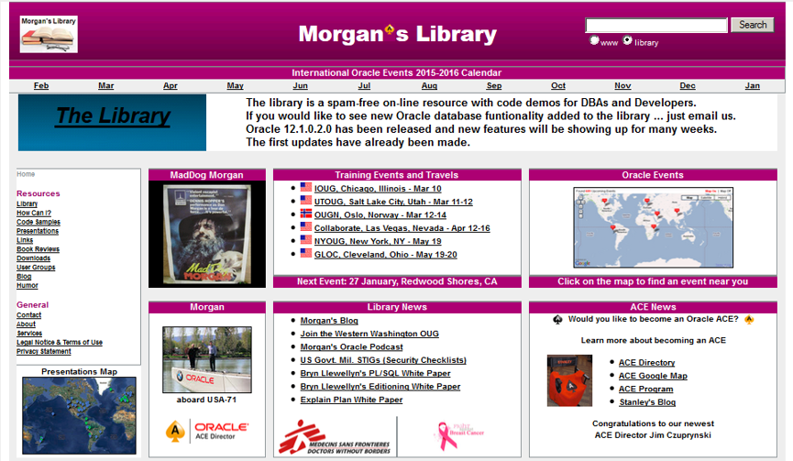
The Morgan's Library Web Site

Slide 6


cd $MORGAN_BASE/San_Francisco

Slide 7

Under the GoldenGate Bridge

Slide 8

To Watch Larry's AC72

Slide 9
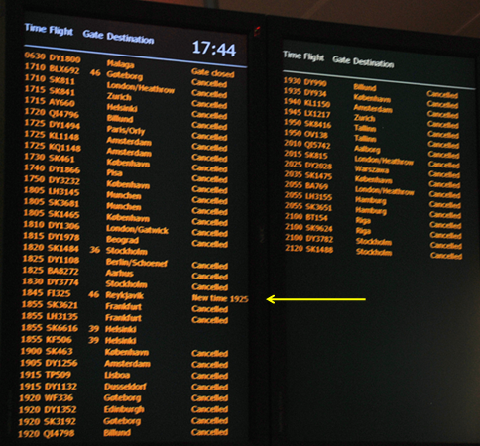
Travel Log: Thank You SAS

Slide 10

Travel Log: Greenland in April

Slide 11

Travel Log: With Jonathan Lewis & Tim Gorman in Beijing

Slide 12
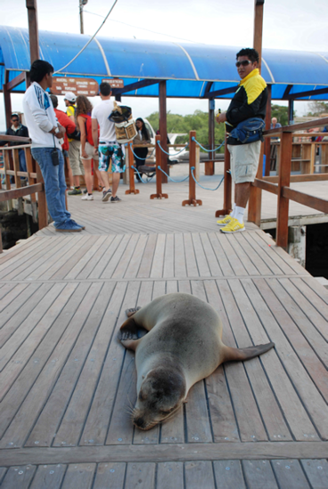
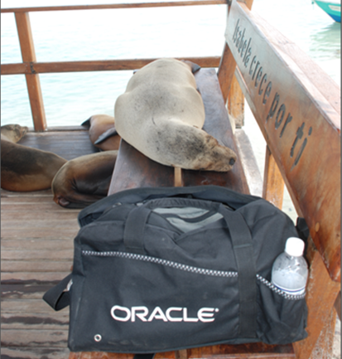
Travel Log: OTN LAD Tour 2014
The most important thing I discovered
during this trip is the how disruptive
our presence was to the locals.

Slide 13
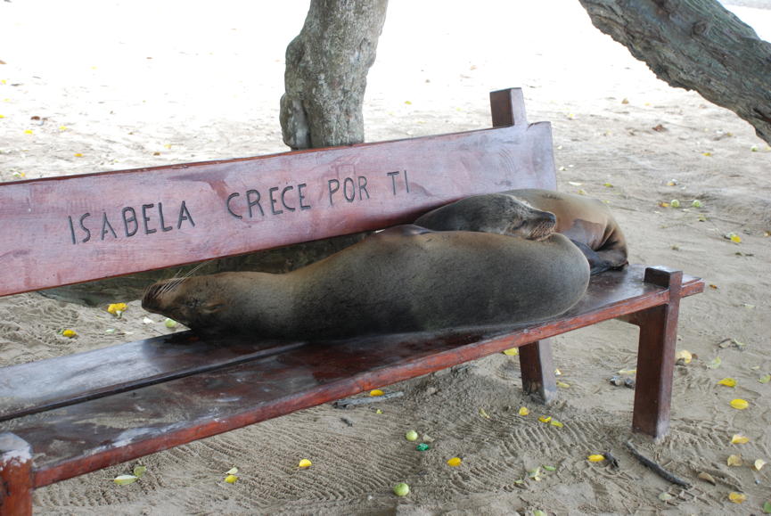
Travel Log: OTN LAD Tour 2014
The most important thing I discovered
during this trip is the how disruptive
our presence was to the locals.

Slide 14
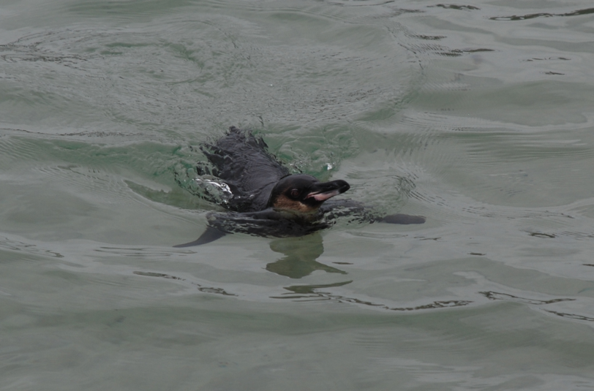
Travel Log: OTN LAD Tour 2014
The most important thing I discovered
during this trip is the how disruptive
our presence was to the locals.

Slide 15
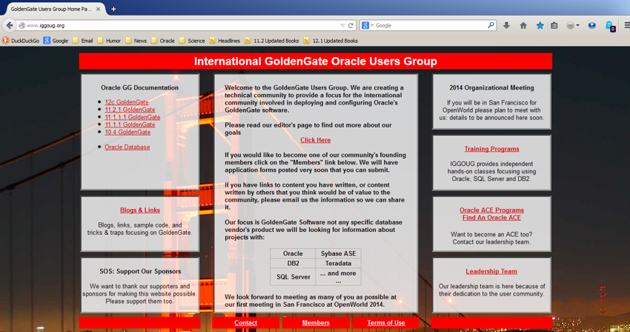
IGGOUG: The New Users Group In The Neighborhood
www.iggoug.org

Slide 16

IGGOUG 2015 Conference

Slide 17

First Principles
If the database is unavailable it is a database problem
If the database is slow it is a database problem
Oracle DBAs are expected to find database problems
To fix the database so the problem never happens again
To write an RCA (Root Cause Analysis) document
Which will point to the database
Even when the database isn't the root cause
Because that is what DBAs are trained to do
Did I mention ... the network is just fine?
Link Lights

Slide 18
My Blog: January 10, 2011
If databases were run with the same degree of intelligence and attentiveness as a network router we would:
log in as SYS, type
SELECT * FROM dual;
and if we did not get an exception, declare everything was fine.
[network admins]..., I might be inclined to recommend that we plug a couple of them into their own networks and see if they light up.

Slide 19

What Is Root Cause Analysis?
Root Cause Analysis is finding, fixing, and reporting on, the event that precipitated a service related incident
The incident or change may have resulted in one or more failures that affected database performance and/or availability
Sometimes the root cause is within the database, for example a bug, it is at least equally probable the database was an innocent bystander
The point is to avoid repeated
fire fighting exercises

Slide 20
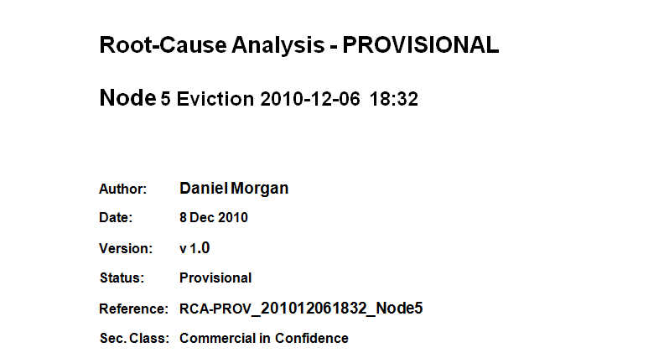
Root Cause Analysis Doc (1:7)

Slide 21
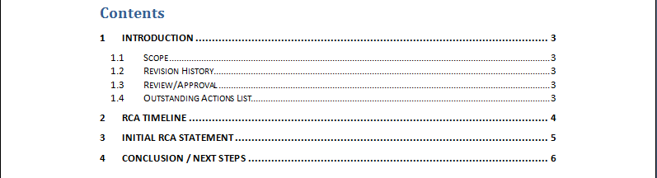
Root Cause Analysis Doc (2:7)

Slide 22
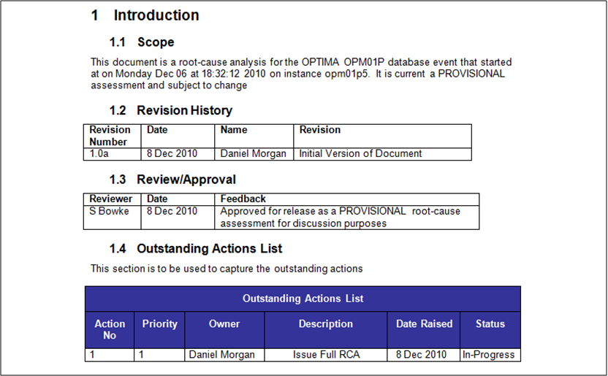
Root Cause Analysis Doc (3:7)

Slide 23
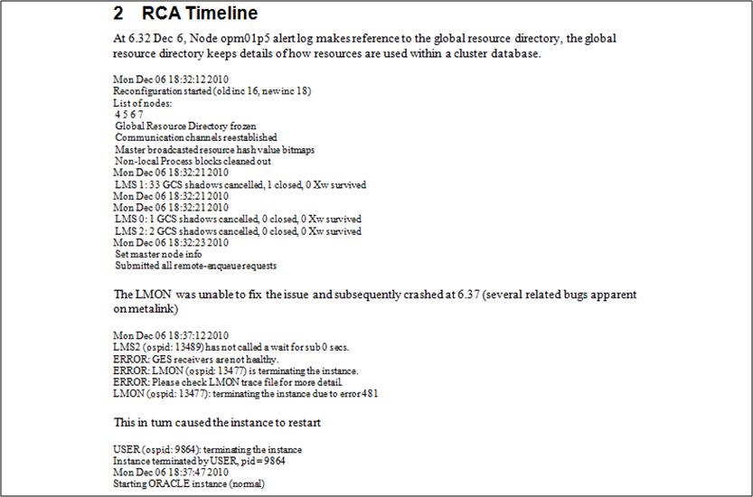
Root Cause Analysis Doc (4:7)

Slide 24
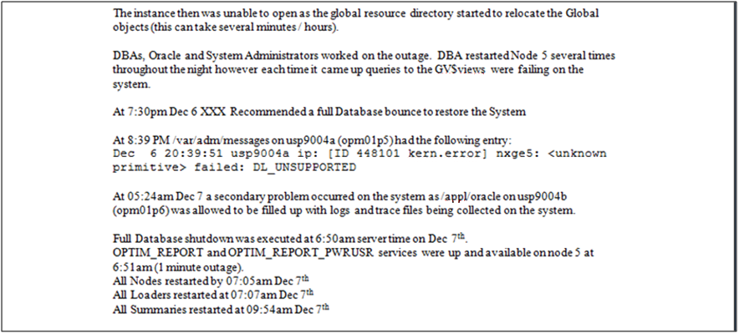
Root Cause Analysis Doc (5:7)

Slide 25
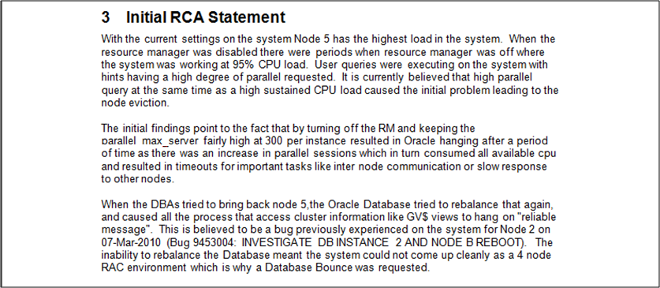
Root Cause Analysis Doc (6:7)

Slide 26
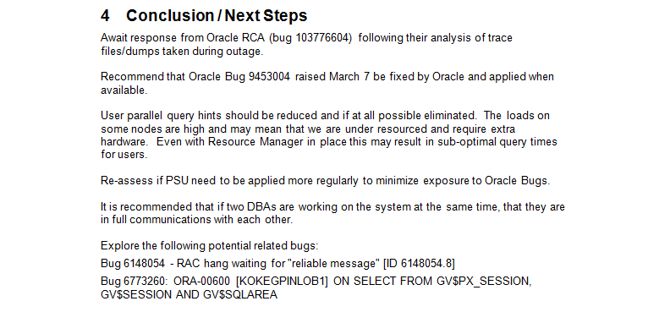
Root Cause Analysis Doc (7:7)

Slide 27
Let's Examine Some Real-World Cases
Case 1: The Puppet Master
Case 2: Jobs and Human Nature
Case 3: More Jobs and Human Nature
Case 4: Port Exhaustion
Case 5: Storage Storage Everywhere
Case 6: UCS (Unimpressive Common Servers)
Case 7: Cisco 5010 to 7010 Migration
Case 8: RAC is RAC: Server Manager is not Optional

Slide 28
Case 1: The Puppet Master

Slide 29
The Outage Fingerprint
Two physically separate two-node RAC clusters. They do not share servers. They do not share storage. They do not share network any component of the cache fusion interconnect ... and yet ... in 7 minutes 7 seconds ... they both go down.
Is it a database problem?
DC20PCE11
Thu Aug 08 16:52:30 2013 Archived Log entry 215974 added for thread 1 sequence 216019 ID 0x2d7ba8f dest 1:
Thu Aug 08 16:57:27 2013 Time drift detected. Please check VKTM trace file for more details.
Thu Aug 08 16:57:43 2013 ERROR: unrecoverable error ORA-29701 raised in ASM I/O path; terminating process 12257
DS20SCE11
Thu Aug 08 16:57:17 2013 Completed checkpoint up to RBA [0xae7f.2.10], SCN: 780145612
Thu Aug 08 17:04:34 2013 Time drift detected. Please check VKTM trace file for more details.
Thu Aug 08 17:04:46 2013 ERROR: unrecoverable error ORA-29701 raised in ASM I/O path; terminating process 2445

Slide 30
Production CRSD Log: 4 Seconds Earlier
ORAP1N1
2013-08-08 16:57:31.162: [ AGFW][1164335424] {0:12:9} Agfw Proxy Server received the message: RESOURCE_STATUS[Proxy] ID 20481:147794
2013-08-08 16:57:31.162: [ AGFW][1164335424] {0:12:9} Received state change for ora.LISTENER_SCAN2.lsnr 1 1 [old state = ONLINE, new state = OFFLINE]
ORAP1N2
2013-08-08 17:09:09.393: [UiServer][1175996736] {2:7473:48658} Done for ctx=0x2aaaac2532b0
2013-08-08 17:09:39.156: [GIPCHDEM][1115060544] gipchaDaemonProcessHAInvalidate: completed ha name invalidate for node 0x2aaaac25bb60 { host 'orap1n1', haName '9f34-b767-de19-a294', srcLuid 04a03a5c-f4851208, dstLuid e3aa430e-82601c00 numInf 2, contigSeq 62781, lastAck 56961, lastValidAck 62780, sendSeq [56961 : 56961], createTime 72155204, flags 0x28 }
P1N1 to P1N2 issue delta: 12 minutes 8 seconds

Slide 31
Staging CRSD Log: 4 Hours 11 Minutes Earlier
ORAS1N1
2013-08-08 13:04:45.315: [ AGFW][1159891264] {0:4:7} Agfw Proxy Server received the message: RESOURCE_STATUS[Proxy] ID 20481:508508
2013-08-08 13:04:45.315: [ AGFW][1159891264] {0:4:7} Received state change for ora.asm oras1n1 1 [old state = ONLINE, new state = UNKNOWN]
ORAS1N2
2013-08-08 13:12:07.199: [ CRSMAIN][96481872] Sync-up with OCR
2013-08-08 13:12:07.199: [ CRSMAIN][96481872] Connecting to the CSS Daemon
2013-08-08 13:12:07.202: [ CRSRTI][96481872] CSS is not ready. Received status 3
2013-08-08 13:12:07.202: [ CRSMAIN][96481872] Created alert : (:CRSD00109:) : Could not init the CSS context, error: 3
2013-08-08 13:12:07.202: [ CRSD][96481872][PANIC] CRSD exiting: Could not init the CSS context, error: 3
S1N1 to S1N2 issue delta: 7 minutes 22 seconds

Slide 32
Staging CSSD Log From S1N1
2013-08-08 17:07:42.784: [ CSSD][1113848128]clssnmSendingThread: sending status msg to all nodes
2013-08-08 17:07:42.784: [ CSSD][1113848128]clssnmSendingThread: sent 4 status msgs to all nodes
2013-08-08 17:07:46.595: [ CSSD][1101232448]clssgmUnregisterShared: Same group share client 1 (0x2aaab0242700), grp DG_LOCAL_DG01, member 0
2013-08-08 17:07:46.596: [ CSSD][1101232448]clssgmTermShare: (0x2aaab00468e0) local grock DG_LOCAL_DG01 member 0 type 1
2013-08-08 17:07:46.596: [ CSSD][1101232448]clssgmUnreferenceMember: local grock DG_LOCAL_DG01 member 0 refcount is 19
2013-08-08 17:07:46.596: [ CSSD][1101232448]clssgmDiscEndpcl: gipcDestroy 0x8ed7f71
2013-08-08 17:07:46.601: [ CSSD][1101232448]clssgmUnregisterShared: Same group share client 1 (0xf0701e0), grp DG_LOCAL_DG01, member 0
2013-08-08 17:07:46.601: [ CSSD][1101232448]clssgmTermShare: (0xf0df060) local grock DG_LOCAL_DG01 member 0 type 1
2013-08-08 17:07:46.601: [ CSSD][1101232448]clssgmUnreferenceMember: local grock DG_LOCAL_DG01 member 0 refcount is 18
2013-08-08 17:07:46.602: [ CSSD][1101232448]clssgmDiscEndpcl: gipcDestroy 0x8f85cc6
2013-08-08 17:07:46.605: [ CSSD][1101232448]clssgmUnregisterShared: Same group share client 2 (0x2aaab0201a20), grp DG_LOCAL_DG02, member 0
2013-08-08 17:07:46.605: [ CSSD][1101232448]clssgmTermShare: (0x2aaab0462f30) local grock DG_LOCAL_DG02 member 0 type 1
2013-08-08 17:07:46.605: [ CSSD][1101232448]clssgmUnreferenceMember: local grock DG_LOCAL_DG02 member 0 refcount is 12
2013-08-08 17:07:46.605: [ CSSD][1101232448]clssgmDiscEndpcl: gipcDestroy 0x8e510f7
2013-08-08 17:07:46.608: [ CSSD][1101232448]clssgmUnregisterShared: Same group share client 2 (0x2aaab0429d00), grp DG_LOCAL_DG02, member 0
2013-08-08 17:07:46.609: [ CSSD][1101232448]clssgmTermShare: (0x2aaab0261ec0) local grock DG_LOCAL_DG02 member 0 type 1
2013-08-08 17:07:46.609: [ CSSD][1101232448]clssgmUnreferenceMember: local grock DG_LOCAL_DG02 member 0 refcount is 11
2013-08-08 17:07:46.609: [ CSSD][1101232448]clssgmDiscEndpcl: gipcDestroy 0x8f33786
2013-08-08 17:07:46.611: [ CSSD][1101232448]clssgmDeadProc: proc 0x2aaab01a1ff0
2013-08-08 17:07:46.611: [ CSSD][1101232448]clssgmDestroyProc: cleaning up proc(0x2aaab01a1ff0) con(0x8ed7f39) skgpid 19273 ospid 19273 with 0 clients, refcount 0
2013-08-08 17:07:46.611: [ CSSD][1101232448]clssgmDiscEndpcl: gipcDestroy 0x8ed7f39
2013-08-08 17:07:46.613: [ CSSD][1101232448]clssgmUnregisterShared: Same group share client 1 (0x2aaab05885e0), grp DG_LOCAL_DG01, member 0
2013-08-08 17:07:46.613: [ CSSD][1101232448]clssgmTermShare: (0x2aaab01f52f0) local grock DG_LOCAL_DG01 member 0 type 1
2013-08-08 17:07:46.613: [ CSSD][1101232448]clssgmUnreferenceMember: local grock DG_LOCAL_DG01 member 0 refcount is 17
2013-08-08 17:07:46.613: [ CSSD][1101232448]clssgmDiscEndpcl: gipcDestroy 0x8e510d8
2013-08-08 17:07:46.616: [ CSSD][1101232448]clssgmUnregisterShared: Same group share client 1 (0x2aaab04eb8b0), grp DG_LOCAL_DG01, member 0
2013-08-08 17:07:46.616: [ CSSD][1101232448]clssgmTermShare: (0x2aaab0430400) local grock DG_LOCAL_DG01 member 0 type 1
2013-08-08 17:07:46.616: [ CSSD][1101232448]clssgmUnreferenceMember: local grock DG_LOCAL_DG01 member 0 refcount is 16
2013-08-08 17:07:46.616: [ CSSD][1101232448]clssgmDiscEndpcl: gipcDestroy 0x8f33736
2013-08-08 17:07:46.618: [ CSSD][1101232448]clssgmDeadProc: proc 0xf13cba0
2013-08-08 17:07:46.618: [ CSSD][1101232448]clssgmDestroyProc: cleaning up proc(0xf13cba0) con(0x8f85c8e) skgpid 18514 ospid 18514 with 0 clients, refcount 0
2013-08-08 17:07:46.618: [ CSSD][1101232448]clssgmDestroyProc: cleaning up proc(0xf13cba0) con(0x8f85c8e) skgpid 18514 ospid 18514 with 0 clients, refcount 0
2013-08-08 17:07:46.618: [ CSSD][1101232448]clssgmDiscEndpcl: gipcDestroy 0x8f85c8e
2013-08-08 17:07:46.622: [ CSSD][1101232448]clssgmDeadProc: proc 0x2aaab030da10
2013-08-08 17:07:46.622: [ CSSD][1101232448]clssgmDestroyProc: cleaning up proc(0x2aaab030da10) con(0x8e510a0) skgpid 4727 ospid 4727 with 0 clients, refcount 0
2013-08-08 17:07:46.622: [ CSSD][1101232448]clssgmDiscEndpcl: gipcDestroy 0x8e510a0
2013-08-08 17:07:46.625: [ CSSD][1101232448]clssgmDeadProc: proc 0x2aaab04e9010
2013-08-08 17:07:46.625: [ CSSD][1101232448]clssgmDestroyProc: cleaning up proc(0x2aaab04e9010) con(0x8f336fe) skgpid 25768 ospid 25768 with 0 clients, refcount 0
2013-08-08 17:07:46.625: [ CSSD][1101232448]clssgmDiscEndpcl: gipcDestroy 0x8f336fe
2013-08-08 17:07:47.795: [ CSSD][1113848128]clssnmSendingThread: sending status msg to all nodes

Slide 33
O/S Log: Four Days Before Incident
Aug 4 04:09:16 orap1n1 Updating DNS configuration for: orap1n1.lux20.morgan.priv
Aug 4 04:09:16 orap1n1 Initial DNS Server: 10.2.198.34
Aug 4 04:09:16 orap1n1 Connecting to DNS server 10.2.198.34
Aug 4 04:09:16 orap1n1 Connected to DNS server 10.2.198.34
Aug 4 04:09:16 orap1n1 Updating both HOST and PTR record for: orap1n1.lux2.morgan.priv
Aug 4 04:09:16 orap1n1 Deleting old reverse lookup records for orap1n1.lux2.morgan.priv on 10.2.198.34.
Aug 4 04:09:17 orap1n1 Adding GSS support to DNS server 10.2.198.34
Aug 4 04:09:17 orap1n1 Added GSS support to DNS server 10.2.198.34
Aug 4 04:09:17 orap1n1 Failed to delete reverse lookup record 11.78.2.10.in-addr.arpa. Reason Refused (5).
Aug 4 04:09:17 orap1n1 Deleting reverse lookup records for our current new IP Address(s) on ad010.lux20.morgan.priv.
Aug 4 04:09:18 orap1n1 No reverse lookup records found for 11.0.168.192.in-addr.arpa on ad010.ams20.morgan.priv.
Aug 4 04:09:18 orap1n1 No reverse lookup records found for 21.34.254.169.in-addr.arpa on ad010.lux20.morgan.priv.
Aug 4 04:09:19 orap1n1 No reverse lookup records found for 12.0.168.192.in-addr.arpa on ad010.lux20.morgan.priv.
Aug 4 04:09:20 orap1n1 No reverse lookup records found for 181.139.254.169.in-addr.arpa on ad010.lux20.morgan.priv.
Aug 4 04:09:20 orap1n1 Failed to delete reverse lookup record 11.78.2.10.in-addr.arpa. Reason Refused (5).
Aug 4 04:09:21 orap1n1 Failed to delete reverse lookup record 10.78.2.10.in-addr.arpa. Reason Refused (5).
Aug 4 04:09:22 orap1n1 Failed to delete reverse lookup record 102.78.2.10.in-addr.arpa. Reason Refused (5).
Aug 4 04:09:22 orap1n1 Failed to delete reverse lookup record 100.78.2.10.in-addr.arpa. Reason Refused (5).
Aug 4 04:09:23 orap1n1 Failed to delete reverse lookup record 14.2.2.10.in-addr.arpa. Reason Refused (5).
Aug 4 04:09:23 orap1n1 Deleting host records for orap1n1.lux20.morgan.priv on ad010.lux20.morgan.priv.
Aug 4 04:09:23 orap1n1 Failed to delete host record for orap1n1.lux20.morgan.priv. Reason Refused (5).
7,824 lines of changes in /var/log/messages on one server
This happened 152 times on ORAP1N1, in DC20, in 6 days

Slide 34
OS Log: Two Days After Incident
Aug 10 12:03:23 orap1n1 Updating DNS configuration for: orap1n1.lux20.morgan.priv
Aug 10 12:03:23 orap1n1 Initial DNS Server: 10.2.198.33
Aug 10 12:03:23 orap1n1 Connecting to DNS server 10.2.198.33
Aug 10 12:03:23 orap1n1 Connected to DNS server 10.2.198.33
Aug 10 12:03:24 orap1n1 Updating both HOST and PTR record for: orap1n1.lux20.morgan.priv
Aug 10 12:03:24 orap1n1 Deleting old reverse lookup records for orap1n1.lux20.morgan.priv on 10.2.198.33.
Aug 10 12:03:24 orap1n1 Adding GSS support to DNS server 10.2.198.33
Aug 10 12:03:24 orap1n1 Added GSS support to DNS server 10.2.198.33
Aug 10 12:03:25 orap1n1 Failed to delete reverse lookup record 11.78.2.10.in-addr.arpa. Reason Refused (5).
Aug 10 12:03:25 orap1n1 Deleting reverse lookup records for our current new IP Address(s) on ad009.lux20.morgan.priv.
Aug 10 12:03:25 orap1n1 No reverse lookup records found for 11.0.168.192.in-addr.arpa on ad009.lux20.morgan.priv.
Aug 10 12:03:26 orap1n1 No reverse lookup records found for 21.34.254.169.in-addr.arpa on ad009.lux20.morgan.priv.
Aug 10 12:03:27 orap1n1 No reverse lookup records found for 12.0.168.192.in-addr.arpa on ad009.lux20.morgan.priv.
Aug 10 12:03:27 orap1n1 No reverse lookup records found for 181.139.254.169.in-addr.arpa on ad009.lux20.morgan.priv.
Aug 10 12:03:28 orap1n1 Failed to delete reverse lookup record 11.78.2.10.in-addr.arpa. Reason Refused (5).
Aug 10 12:03:28 orap1n1 Failed to delete reverse lookup record 10.78.2.10.in-addr.arpa. Reason Refused (5).
Aug 10 12:03:29 orap1n1 Failed to delete reverse lookup record 101.78.2.10.in-addr.arpa. Reason Refused (5).
Aug 10 12:03:30 orap1n1 Failed to delete reverse lookup record 14.2.2.10.in-addr.arpa. Reason Refused (5).
Aug 10 12:03:30 orap1n1 Deleting host records for orap1n1.lux20.morgan.priv on ad009.lux20.morgan.priv.
Aug 10 12:03:30 orap1n1 Failed to delete host record for orap1n1.lux20.morgan.priv. Reason Refused (5).
Aug 10 12:03:30 orap1n1 Updating host records for orap1n1.lux20.morgan.priv on ad009.lux20.morgan.priv.
Aug 10 12:03:31 orap1n1 Failed to update host records orap1n1.lux20.morgan.priv: Reason Refused (5).

Slide 35
Log File Research
To: <system and storage admins>
Cc: <management>
Subject: Need Hardware Information
Here is the signature of the ASM failure in DC20 over the last two days. Two different databases on different blades:
*** 2013-08-09 11:49:20.023
NOTE: ASMB terminating
ORA-15064: communication failure with ASM instance
ORA-03113: end-of-file on communication channel
Process ID:
Session ID: 82 Serial number: 9
error 15064 detected in background process
ORA-15064: communication failure with ASM instance
ORA-03113: end-of-file on communication channel
Process ID:
Session ID: 82 Serial number: 9
kjzduptcctx: Notifying DIAG for crash event
----- Abridged Call Stack Trace -----
ksedsts()+461<-kjzdssdmp()+267<-kjzduptcctx()+232<-kjzdicrshnfy()+53<-ksuitm()+1325<-ksbrdp()+3344<-opirip()+623<-opidrv()+603<-sou2o()+103<-opimai_real()+266<-ssthrdmain()+252<-main()+201<-__libc_start_main()+244<-_start()+36
----- End of Abridged Call Stack Trace -----
*** 2013-08-09 11:49:20.134
ASMB (ospid: 15341): terminating the instance due to error 15064
ksuitm: waiting up to [5] seconds before killing DIAG(15317)
Can you help me please with the following:
1. Are all database blades in the same or different chassis?
2. What is the storage solution? VSP, NetApp? What diagnostics can we pull?
3. What network infrastructure between the blades and the storage array? What diagnostics can we pull?

Slide 36
O/S Log: Ruby on RAC?
Aug 8 13:04:22 orap1n1 ERROR: While executing gem ... (Gem::RemoteFetcher::FetchError)
Aug 8 13:04:22 orap1n1 Errno::ETIMEDOUT: Connection timed out - connect(2) (http://rubygems.org/latest_specs.4.8.gz)
Aug 8 13:04:22 orap1n1 INFO: `gem install -y` is now default and will be removed
Aug 8 13:04:22 orap1n1 INFO: use --ignore-dependencies to install only the gems you list
Aug 8 15:42:41 orap1n1 ERROR: While executing gem ... (Gem::RemoteFetcher::FetchError)
Aug 8 15:42:41 orap1n1 Errno::ETIMEDOUT: Connection timed out - connect(2) (http://rubygems.org/latest_specs.4.8.gz)
Aug 8 15:42:41 orap1n1 INFO: `gem install -y` is now default and will be removed
Aug 8 15:42:41 orap1n1 INFO: use --ignore-dependencies to install only the gems you list
This happened twice just before the outage
the first time 3 hours 53 seconds before the outage
The second time 1 hour 15 minutes before the outage

Slide 37
O/S Log: NTP Time Synchronization
Aug 8 12:56:04 orap1n1 ntpd[1339]: ntpd exiting on signal 15
Aug 8 12:57:27 orap1n1 ntpdate[12406]: step time server 10.2.255.254 offset 82.262906 sec
Aug 8 12:57:27 orap1n1 ntpd[12408]: ntpd 4.2.2p1@1.1570-o Fri Jul 22 18:07:53 UTC 2011 (1)
Aug 8 12:57:27 orap1n1 ntpd[12409]: precision = 1.000 usec
Aug 8 12:57:27 orap1n1 ntpd[12409]: Listening on interface wildcard, 0.0.0.0#123 Disabled
Aug 8 12:57:27 orap1n1 ntpd[12409]: Listening on interface wildcard, ::#123 Disabled
Aug 8 12:57:27 orap1n1 ntpd[12409]: Listening on interface bond2, fe80::217:a4ff:fe77:fc18#123 Enabled
Aug 8 12:57:27 orap1n1 ntpd[12409]: Listening on interface lo, ::1#123 Enabled
Aug 8 12:57:27 orap1n1 ntpd[12409]: Listening on interface bond0, fe80::217:a4ff:fe77:fc10#123 Enabled
Aug 8 12:57:27 orap1n1 ntpd[12409]: Listening on interface eth2, fe80::217:a4ff:fe77:fc14#123 Enabled
Aug 8 12:57:27 orap1n1 ntpd[12409]: Listening on interface eth3, fe80::217:a4ff:fe77:fc16#123 Enabled
Aug 8 12:57:27 orap1n1 ntpd[12409]: Listening on interface lo, 127.0.0.1#123 Enabled
Aug 8 12:57:27 orap1n1 ntpd[12409]: Listening on interface eth2, 192.168.0.11#123 Enabled
Aug 8 12:57:27 orap1n1 ntpd[12409]: Listening on interface eth2:1, 169.254.34.21#123 Enabled
Aug 8 12:57:27 orap1n1 ntpd[12409]: Listening on interface eth3, 192.168.0.12#123 Enabled
Aug 8 12:57:27 orap1n1 ntpd[12409]: Listening on interface eth3:1, 169.254.139.181#123 Enabled
Aug 8 12:57:27 orap1n1 ntpd[12409]: Listening on interface bond0, 10.2.78.11#123 Enabled
Aug 8 12:57:27 orap1n1 ntpd[12409]: Listening on interface bond0:1, 10.2.78.10#123 Enabled
Aug 8 12:57:27 orap1n1 ntpd[12409]: Listening on interface bond0:3, 10.2.78.102#123 Enabled
Aug 8 12:57:27 orap1n1 ntpd[12409]: Listening on interface bond0:4, 10.2.78.100#123 Enabled
Aug 8 12:57:27 orap1n1 ntpd[12409]: Listening on interface bond2, 10.2.2.14#123 Enabled
Aug 8 12:57:27 orap1n1 ntpd[12409]: kernel time sync status 0040
Aug 8 12:57:27 orap1n1 ntpd[12409]: frequency initialized 0.000 PPM from /var/lib/ntp/drift

Slide 38
The Puppet Master Conclusions
Two physically distinct RAC clusters were brought down by the use of a totally inappropriate tool by people that did not understand the implications of what they were doing
The DBA team was never informed that the activity was going to take place
The DBA team had no access to the change logs
The databases were innocent bystanders and there was nothing the DBA team could have done to prevent the outage
IT management was at fault for the outage by creating a situation with
  Inadequate communications
  Inadequate training for non-DBAs

Slide 39
Case 2: Jobs and Human Nature

Slide 40
Repeating Issue: User Configured Loads
RAC Server Node 1
MMDD 00 01 02 03 04 05 06 07 08 09 10 11 12 13 14 15 16 17 18 19 20 21 22 23
---- ---- ---- ---- ---- ---- ---- ---- ---- ---- ---- ---- ---- ---- ---- ---- ---- ---- ---- ---- ---- ---- ---- ---- ----
0804 0 0 0 0 0 0 0 0 0 0 0 0 5 32 18 65 91 13 12 20 84 9 14 9
0805 137 112 26 27 141 17 21 9 85 13 21 17 96 23 23 24 91 13 11 21 86 11 14 9
0806 151 111 21 24 96 41 50 14 84 22 20 22 91 18 17 18 92 24 10 11 83 9 14 20
0807 139 100 32 30 99 43 49 19 105 17 31 14 76 23 27 25 111 20 15 18 86 13 13 10
0808 145 99 29 30 109 52 48 11 102 25 47 24 101 23 20 23 117 31 30 16 91 12 11 9
0809 123 83 65 37 93 17 25 10 102 23 44 25 111 37 24 29 98 19 29 16 92 16 15 9
0810 169 120 52 32 125 58 38 9 109 17 26 14 104 13 17 15 93 13 16 11 61 10 10 9
0811 107 82 51 34 85 17 22 10 73 10 12 11 92 32 13 69 65 11 11 10 60 9 12 9
0812 149 121 26 15 70 16 24 11 95 34 15 18 34 67 21 21 87 11 13 9 77 9 14 9
0813 115 76 55 56 27 9 9 9 11 9 9 0 0 0 0 0 0 0 0 0 0 0 0 0
60 corresponds to one change per minute ... the ideal range is 4 to 12 Addressed by resizing redo logs from 400MB to 4GB
And rescheduling many of the jobs

Slide 41
Jobs And Human Nature Conclusions
DBAs must be able to control when and where jobs are scheduled based on run time and resource requirements
Applications should NEVER be allowed to schedule multiple jobs to start at the exact same point-in-time
Developers need to have partial ownership the problem
None of this is likely to ever happen so DBAs need to play defense and monitor job scheduling by creating their own alerts
IT management was at fault for the performance hits due to
  Inadequate communications
  Inadequate training for non-DBAs

Slide 42
Case 3: More Jobs and Human Nature

Slide 43
Unobserved Job Failure
SQL> SELECT owner, job_name, job_type, trunc(start_date) SDATE, trunc(next_run_date) nxtrun, failure_count
2 FROM dba_scheduler_jobs
3* WHERE failure_count <> 0;
OWNER JOB_NAME STATE SDATE NXTRUN FAILURE_COUNT
--------------- ------------------------------ ---------- -------------------- -------------------- -------------
SYS SM$CLEAN_AUTO_SPLIT_MERGE SCHEDULED 14-MAR-2011 00:00:00 14-AUG-2013 00:00:00 17
SYS RSE$CLEAN_RECOVERABLE_SCRIPT SCHEDULED 14-MAR-2011 00:00:00 14-AUG-2013 00:00:00 20
SYS DRA_REEVALUATE_OPEN_FAILURES SCHEDULED 10
ORACLE_OCM MGMT_CONFIG_JOB SCHEDULED 4
EXFSYS RLM$SCHDNEGACTION SCHEDULED 13-AUG-2013 00:00:00 13-AUG-2013 00:00:00 3
EXFSYS RLM$EVTCLEANUP SCHEDULED 27-APR-2011 00:00:00 13-AUG-2013 00:00:00 2
RDBA5 LONG_RUN_SESS_JOB SCHEDULED 12-AUG-2013 00:00:00 13-AUG-2013 00:00:00 1
EISAI_PROD_TMS POPULATE_MORGAN_CATALOG DISABLED 01-JUN-2009 00:00:00 08-AUG-2013 00:00:00 2559

Slide 44
Another Unobserved Job Failure
SQL> SELECT owner, job_name, job_type, state, trunc(start_date) SDATE, trunc(next_run_date) NXTRUN, failure_count
2 FROM dba_scheduler_jobs
3 WHERE failure_count > 0
4* ORDER BY 6;
OWNER JOB_NAME STATE SDATE NXTRUN FAILURE_COUNT
--------------- ------------------------------ ---------- -------------------- -------------------- -------------
SYS PVX_STUDENT SCHEDULED 29-MAR-2013 09-AUG-2013 122
Called out in Jira CO-9060 for the following exception:
r-succe-ds:aukoras1n4 Logscan matched patterns in /app/oracle/base/diag/rdbms/auksce54/AUKSCE541/trace/alert_AUKSCE541.log RDBA WARN + Errors in file /app/oracle/base/diag/rdbms/auksce54/AUKSCE541/trace/AUKSCE541_j000_12172.trc: + ORA-12012: error on auto execute of job "SYS"."PVX_STUDENT_REFRESH" W ORA-06550: line 1, column 797: + PLS-00103: Encountered the symbol "PVX_STUDENT" when expecting one of the following: + + ) , * & = - + < / > at in is mod remainder not rem => + <> or != or ~= >= <= <> and or like like2 + like4 likec as between from using || multiset member -------------------------- alert.pl v5.3.120207 mon_hub:auktusc01 (auktusc01) run_time:2013-Aug-08 08:01:43 client:R-SUCCE-DS server:auktusc01 entity:aukoras1n4 entity_type:OPSYS processed by ftp_mail_proc.pl on delphi at 8-Aug-2013 07:03

Slide 45
Jobs And Human Nature Conclusions
Sorry DBAs you don't get off blameless on this one
As a DBA you MUST know what is happening on your system and you need to monitor more than just your email and the alert log
  /var/log/messages
  alert log
  clusterware logs
  ASM log
  listener log
  backup logs
  job scheduling logs
  AUD$ and FGA$
  SQL*Loader and External table loading logs
  DataPump logs
  And no you can not rely on OEM Cloud Control for most of this

Slide 46
Case4: Port Exhaustion
Hint: It is not caused by drinking too much port

Slide 47
In The Beginning (1:4)
Customer Reports are stuck in the queue
Hi Ops
Report Jobs are getting stuck in Waiting in Queue. Also, having performance issues with Admin side
Thanks,
J
Step to Recreate
1. Log into Website
2. Navigate to Reports
3. Search for Account Data
4. Run the report for morgand
5. Notice that the report is stuck in Waiting in Queue

Slide 48
In The Beginning (2:4)
The website generated an HTTP403 error
As a partner we got communication that the previously assigned sandboxes will be brought down.
Instead -as a partner- we got a them demo environment assigned (Tenant ID: PARTNER0001 which we have integrated with a customer database instance (xxxdemo ace4morgan).
Everything was working fine (including integration).
Today I tried to access the instance via the partner and via the direct url (https://partner0001.demo.xxx.com/admin/nativelogin.jsp) but in both case an error is displayed on the screen (see attachment).
We need this be fixed as soon as possible!
(major customer demo session on Friday!)

Slide 49
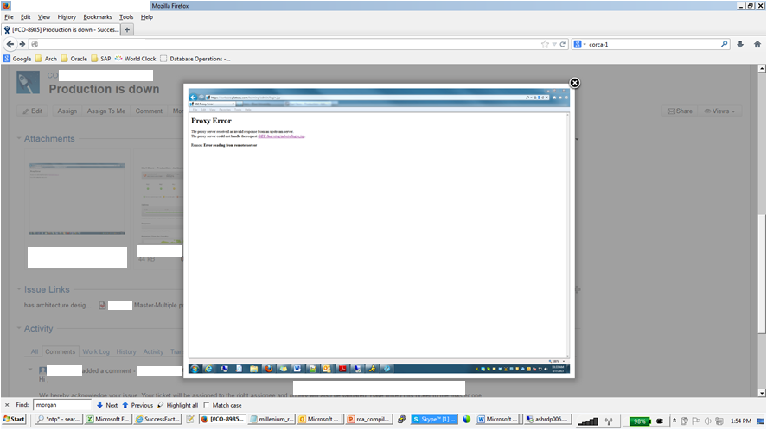
In The Beginning (3:4)

Slide 50
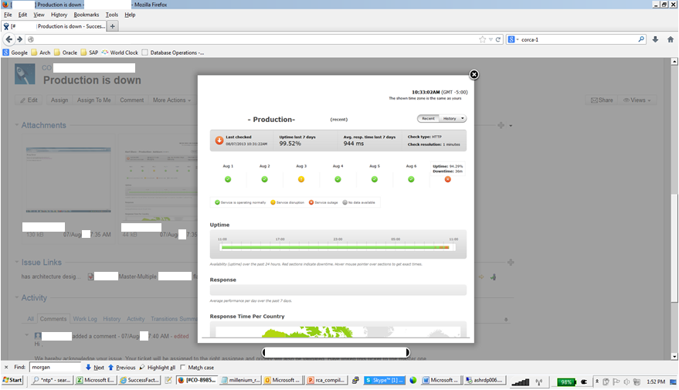
In The Beginning (4:4)

Slide 51
How Does An Application Server Connect to RAC?
Do you connect to the SCAN IP by name or number?
If a name ... a DNS server resolves the name to an IP
To avoid single points of failure you should have two or more DNS servers with a load balancer, or two, in front of them
The SCAN IP points to a VIP which may again need to be resolved from a name to a physical IP address
The VIP may again point to a name which must be resolved to a physical IP address
Most servers cache DNS entries to improve speed
  Do you know if yours do?

Slide 52
Triaging a Connection Problem
Try to connect to the cluster?
  From where?
  With what tool?
  To the SCAN, VIP, or physical IP?
Ping the IP addresses
Run Trace Route on the IP addresses
Read the listener log
Read the database alert log
Call the network admins who will tell you
everything looks good ...
the network is just Ok ...
the network is always Ok
the network will always be Ok

Slide 53
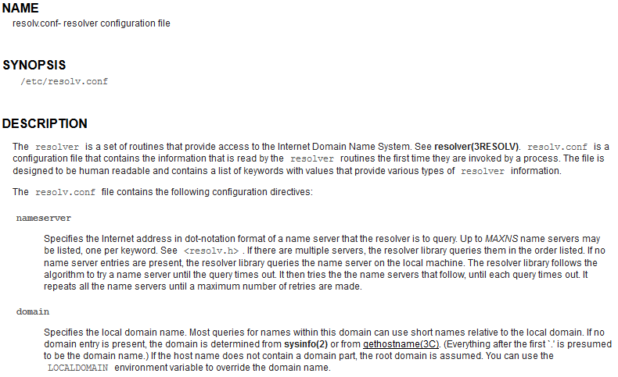
RESOLVE.CONF (1:3)

Slide 54
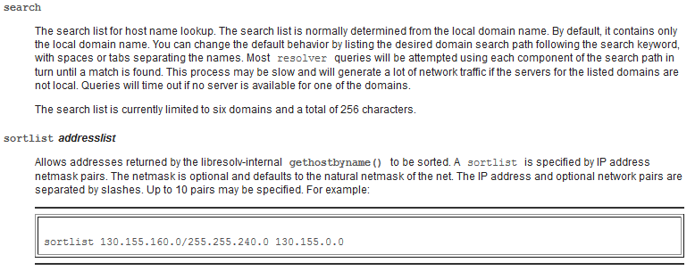
RESOLVE.CONF (2:3)

Slide 55
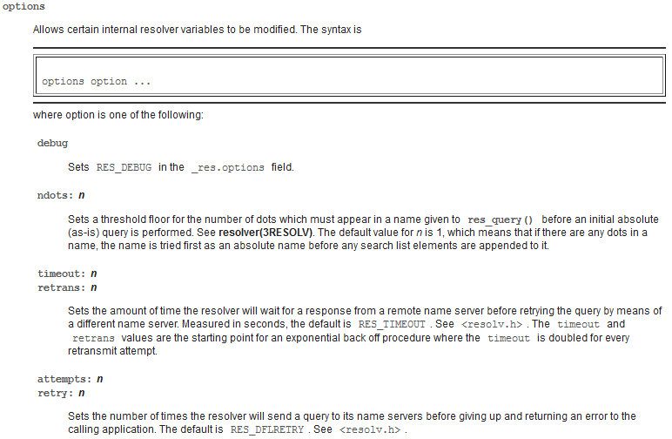
RESOLVE.CONF (3:3)

Slide 56
Resolution: The DNS Admin POV
On August 7th, we experienced a 2 hour outage that impacted more than 150 customers. In researching this outage it was noticed that DNS caching had been disabled on the Oracle Database Servers. Also, in going through the logs on the F5 Local Traffic Manager (LTM), is was noticed that there were 39,696 port exhaustion errors on port 53 going to the three DNS servers, starting at approximately 4am and ending slightly after 3pm. There were also an additional 625,665 port exhaustion error messages that were dropped in the logs, bringing the total to 665,361 port exhaustion error messages.
Further research discovered that there was a misconfiguration in the resolv.conf file on the servers in the data center. The resolv.conf file on these servers looked like this:
search morgan.priv
nameserver 10.24.244.200 (VIP pointing to servers listed below)
nameserver 10.24.244.21 (Bind server 01)
nameserver 10.24.244.25 (Bind server 02)
nameserver 10.24.244.29 (Bind server 03)
This results in the first DNS query going to the VIP for hostname and reverse IP resolution, and then to the three DNS servers. However, the 3 DNS servers which were supposed to be the alternative option to the VIP are also pointing to the same VIP. This basically sets up an infinite loop until the DNS queries time out.
The recommended resolution was to remove the VIP and have the servers query the DNS servers directly.

Slide 57
Resolution: The DNS Admin POV
These graphs give an overview of what was happening throughout August 7th on the servers. I noticed that there is a sudden drop in connections right around 10:40am; and returning at around 10:45 am.
If you look at the files I’ve sent out previously, there is actually less evidence of port exhaustion between 10:22 and 10:42; with increasing levels of port exhaustion as connections and activity increases after about 12:07pm.
Additionally, I went back over the last few days and looked for port exhaustion for the DNS servers on port 53 and found the following:
Jul 29 – 16 port exhaustion errors
Jul 30 – 7 port exhaustion errors
Jul 31 – 8 port exhaustion errors
Aug 1 – 6 port exhaustion errors
Aug 2 – 38,711 port exhaustion errors
Aug 3 – 26,023 port exhaustion errors
Aug 4 – 22,614 port exhaustion errors
Aug 5 – 20 port exhaustion errors
Aug 6 – 11,282 port exhaustion errors

Slide 58
Resolution: The DNS Admin POV
Additionally, I did some calculations on the additional port exhaustion log messages that were dropped – these were the throttling error that I mentioned previously.
On the 7th of August there were an additional 625,665 port exhaustion error messages that were dropped. On August 3rd, there were an additional 99,199 port exhaustion error messages that were dropped.
And on August 2nd, there were an additional 204,315 port exhaustion error messages that were dropped.
These numbers are in addition to the numbers of port exhaustion errors previously reported.

Slide 59
Resolution: The System Admin POV
Every unix box at the LAX data center has this resolv.conf file:
search morgan.priv
nameserver 10.24.244.200 (VIP pointing to both AD01 and AD02 windows servers)
nameserver 10.24.244.21 (Bind server 01)
nameserver 10.24.244.25 (Bind server 02)
nameserver 10.24.244.29 (Bind server 03)
The idea behind this design is to firstly query the VIP (for hostname resolution) and then, the 3 bind servers which are slave DNS servers of the AD DNS servers described above.
Now, I've found that the BIND servers (unix) which are supposed to be the alternative option to the VIP, have the same /etc/resolv.conf file and therefore are also pointing to the VIP on the first place. As you can imagine this basically ends up in an infinite loop until the load balancer get finally some relief or the DNS queries timeout.
Refer to the attachment "Morgan current arch" to see the workflow.
The fix should be easy and basically would consist of removing the VIP from the /etc/resolv.conf from the Bind servers and have them pointing to each AD server (bind01 -> AD01, bind02 -> AD02, etc).
The ultimate solution would be to remove the VIP from all the /etc/resolv.conf files and query the BIND servers (Helen has been asking for this for months) and although we have done that in the DEN environment, apparently that hasn't been done on the LAX side yet.

Slide 60
Port Exhaustion Conclusions
As a DBA you MUST understand how DNS is configured for every one of your databases
As a DBA you MUST understand resolv.conf and monitor it for content and changes
As a DBA you MUST educate DNS and System Admins about how to connect to a RAC cluster or a standby
As a DBA, when troubleshooting connection issues, you MUST log in from an application server to identify what is actually going on ... you can't just FTP to the box

Slide 61
Case 5: Storage Storage Everywhere
and not a byte to to fill

Slide 62
Processing Stops and the NOC says
[Ticket] Commented: (1246816) mount points filled 100% on dc1laxdb01 and dc1laxdb03
Hi,
Two mounts got filled 100%, please add space as early as possible.
/u108 on dc1laxdb01
/export/home on dc1laxdb03
There are only datafiles in both mount points,
Thanks
Murphy

Slide 63
Ticket 1246816
-bash-3.00$ df -h
Filesystem size used avail capacity Mounted on
/dev/md/dsk/d100 37G 11G 26G 29% /
/devices 0K 0K 0K 0% /devices
ctfs 0K 0K 0K 0% /system/contract
proc 0K 0K 0K 0% /proc
mnttab 0K 0K 0K 0% /etc/mnttab
swap 61G 2.1M 61G 1% /etc/svc/volatile
objfs 0K 0K 0K 0% /system/object
sharefs 0K 0K 0K 0% /etc/dfs/sharetab
fd 0K 0K 0K 0% /dev/fd
/dev/md/dsk/d500 20G 4.6G 15G 24% /var
swap 62G 1.4G 61G 3% /tmp
swap 61G 142M 61G 1% /var/run
/dev/dsk/c6t600601606AD11900E033B69AFA43DD11d0s2
115G 46G 68G 41% /u01
/dev/md/dsk/d132 31G 2.2G 29G 8% /var/crash
/dev/md/dsk/d60 9.8G 6.4G 3.3G 66% /export/home
/dev/md/dsk/d402 422M 5.1M 374M 2% /global/.devices/node@2
/dev/md/dsk/d404 481M 5.0M 428M 2% /global/.devices/node@4
/dev/md/dsk/d401 415M 74M 299M 20% /global/.devices/node@1
/dev/md/dsk/d403 481M 5.0M 428M 2% /global/.devices/node@3
/dev/md/sf14/dsk/d112 4.2T 4.1T 34G 100% /u112
/dev/md/sf14/dsk/d101 2.1T 2.0T 52G 98% /u101
/dev/md/sf14/dsk/d109 2.1T 1.8T 239G 89% /u109
/dev/md/sf14/dsk/d111 197G 3.5G 191G 2% /u111
/dev/md/sf14/dsk/d100 2.1T 2.0T 31G 99% /u100
/dev/md/sf14/dsk/d107 264G 73G 188G 28% /u107
/dev/md/sf14/dsk/d102 1.0T 1005G 58G 95% /u102
/dev/md/sf14/dsk/d106 264G 36G 225G 14% /u106
/dev/md/sf14/dsk/d113 4.0T 3.6T 326G 92% /u113
/dev/md/sf14/dsk/d110 3.0T 946G 2.0T 32% /u110_arch
/dev/md/sf14/dsk/d104 2.0T 1.9T 37G 99% /u104
/dev/md/sf14/dsk/d105 2.0T 2.0T 537M 100% /u105
/dev/md/sf14/dsk/d108 2.0T 2.0T 2.0G 100% /u108
/dev/md/sf14/dsk/d103 2.0T 1.9T 47G 98% /u103

Slide 64

Storage Admin Tauntage: Let's Do Some Math
Total | Available
31 | 29
10 | 3
4200 | 34
2100 | 52
2100 | 239
197 | 191
2100 | 31
264 | 188
1000 | 58
264 | 225
4000 | 326
3000 | 2000
2000 | 37
2000 | 1
2000 | 2000
2000 | 47
27,266 | 5,461
The database is stopped because "they are out of space."
Yet 20% of the space allocated has never been used.

Slide 65
And That's Not Counting Free Space
SQL> SELECT file_name, tablespace_name
2 FROM dba_data_files
3 WHERE autoextensible = 'YES'
4 ORDER BY 1;
FILE_NAME TABLESPACE_NAME
------------------------------------------------------- ----------------
/u113/oradata/SF14/datafile/o1_mf_lob_01_8jlsmo05_.dbf LOB_01
/u113/oradata/SF14/datafile/o1_mf_lob_01_8jlst7ky_.dbf LOB_01
/u113/oradata/SF14/datafile/o1_mf_lob_01_8jlsx6fr_.dbf LOB_01
/u113/oradata/SF14/datafile/o1_mf_lob_01_8jlt035w_.dbf LOB_01
/u113/oradata/SF14/datafile/o1_mf_lob_01_8jlt34sd_.dbf LOB_01
/u113/oradata/SF14/datafile/o1_mf_lob_01_8rs5xndc_.dbf LOB_01
/u113/oradata/SF14/datafile/o1_mf_lob_01_8vdx8bps_.dbf LOB_01
/u113/oradata/SF14/datafile/o1_mf_lob_01_8vdx9r68_.dbf LOB_01
/u113/oradata/SF14/datafile/o1_mf_lob_01_8vdxc5ks_.dbf LOB_01
/u113/oradata/SF14/datafile/o1_mf_lob_01_8vdxf9v1_.dbf LOB_01
10 rows selected.
SQL> select sum(bytes)/1024/1024/1024 FREE_SPACE
2 from dba_free_space
3 where tablespace_name = 'LOB_01';
FREE_SPACE
----------
6166.08484

Slide 66
How Much Free Space Is There Really?
Hard disk not fully occupied by data files
Data files not fully occupied by segments
Segments with extents above the high water mark
Partially filled blocks
Full blocks with empty space due to the PCTFREE setting
LOB tablespace space occupied by undo data
And yet the database is "out of space"
Vaccum | Wasted
Not allocated for data files | 5.5T
Freespace in LOB Tablespace | 6.2T
Space in used blocks | 2.3T
Total | 14T (more than 50% of the 27.3T allocated)

Slide 67
How Much Disk Space Really Isn't Real
Disk space too small for another datafile
Tablespaces with too little room for another extent
Space that has been over-allocated due to storage virtualization

Slide 68
Storage Usage Conclusions
Bytes that spin cost
  money to purchase them
  money to provide electricity to spin them
  money to provide air conditioning to cool them
  money to pay for the floor space they occupy
Wasting space is wasting money
Advanced and Hybrid Columnar Compression will not address the issues created by poor planning and usage
You probably don't need pct_free set at 0%
If you store BLOBs and CLOBs you need to know how much space is wasted storing undo
Bigfile tablespaces are superior very often to Smallfiles
There is almost no justification for lots of tablespaces and lots of datafiles: If you do it you must justify it

Slide 69
Case 6: UCS
and all the other blade servers we don't need and never asked for

Slide 70
But first ...
Network stability is critical to Oracle DBAs
If you have network issues you can waste staggering amounts of time proving the issue isn't the database
I have worked for the last 10 months with Cisco UCS
  ~10 databases stand-alone 11gR2
  ~75 RAC Active-Active or Clusterware Active-Passive Failover
The questions that need to be addressed are
  What is the value of failover to a cluster?
  What is the value of functioning network diagnostics?

Slide 71
VLANs and the Cluster Interconnect (1:2)
It is essentially impossible do what is recommended in Oracle Support's "best practices" guidelines for RAC with blades: any blades from any vendor
RAC: Frequently Asked Questions (Doc ID 220970.1)
Cluster interconnect network separation can be satisfied either by using standalone, dedicated switches, which provide the highest degree of network isolation, or Virtual Local Area Networks defined on the Ethernet switch, which provide broadcast domain isolation between IP networks. VLANs are fully supported for Oracle Clusterware interconnect deployments. Partitioning the Ethernet switch with VLANs allows for:
- Sharing the same switch for private and public communication.
- Sharing the same switch for the private communication of more than one cluster.
- Sharing the same switch for private communication and shared storage access.
The following best practices should be followed:
The Cluster Interconnect VLAN must be on a non-routed IP subnet.
All Cluster Interconnect networks must be configured with non-routed IPs. The server-server communication should be single hop through the switch via the interconnect VLAN. There is no VLAN-VLAN communication.
Oracle recommends maintaining a 1:1 mapping of subnet to VLAN.
The most common VLAN deployments maintain a 1:1 mapping of subnet to VLAN. It is strongly recommended to avoid multi-subnet mapping to a single VLAN. Best practice recommends a single access VLAN port configured on the switch for the cluster interconnect VLAN. The server side network interface should have access to a single VLAN.

Slide 72
VLANs and the Cluster Interconnect (2:2)
It is extremely difficult to troubleshoot interconnect issues with UCS as the tools for separating public, storage, and fusion interconnect packets do not exist
Troubleshooting gc block lost and Poor Network Performance in a RAC Environment (Doc ID 563566.1)
6. Interconnect LAN non-dedicated
Description: Shared public IP traffic and/or shared NAS IP traffic, configured on the interconnect LAN will result in degraded application performance, network congestion and, in extreme cases, global cache block loss.
Action: The interconnect/clusterware traffic should be on a dedicated LAN defined by a non-routed subnet. Interconnect traffic should be isolated to the adjacent switch(es), e.g. interconnect traffic should not extend beyond the access layer switch(es) to which the links are attached. The interconnect traffic should not be shared with public or NAS traffic. If Virtual LANs (VLANS) are used, the interconnect should be on a single, dedicated VLAN mapped to a dedicated, non-routed subnet, which is isolated from public or NAS traffic.

Slide 73
My Experience
Blade servers, of which Cisco UCS are just one example, do not have sufficient independent network paths to avoid the networking becoming a single point of failure
It is good when the public interface has a "keep alive" enabled but this is a fatal flaw for the cluster interconnect
When different types of packets, public, storage, and interconnect are mixed low-level diagnostics are difficult if not impossible
When different types of packets, public, storage, and interconnect are mixed the latency of one is the latency of all
Traffic from any one blade impacts all blades

Slide 74
UCS Blade Server Conclusions
Blade servers may be a good solution for application and web servers
They may even be acceptable for stand-alone databases
Blade servers are unsuitable when
  High availability is the goal
  RAC the technology for achieving it
  Performance is critically important
  You don't want to stay at work at night, on weekends, and holidays troubleshooting repeated unexplained failures

Slide 75
Case 7: 5010 <> 7010
Things can break even when nothing is broken

Slide 76
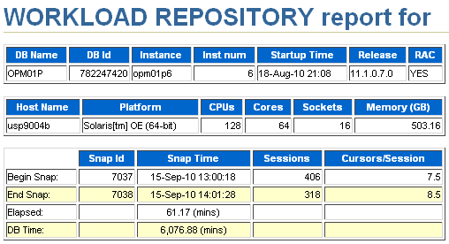
What You Can't See Matters
6 Node RAC Cluster ... each node is an Sun M9000
Storage is 3 clustered EMC VMax arrays = 1.25PB
Public is bonded and redundant 10gEth
The initial fusion interconnect is a single Cisco 5010
The new interconnect is two bonded Cisco 7010s
What could possibly go wrong?

Slide 77
The First Node Always Starts
Shutdown the RAC Cluster
Pull 10gEth from Cisco 5010 and plug into Cisco 7010
Start any one node of the cluster
No other node joins the cluster: the order doesn't matter
Plug cables back into the 5010 and all is well
Cisco engineers verify the 7010 is in perfect condition
Repeat the above steps ... result is the same no matter which node is started first ... no other node can join the cluster
Repeat numerous times with different start orders ... the result is always the same

Slide 78
What Is Happening?
The first node started registers itself with the voting disk and knows no other nodes have started
The second node, no matter which one is second, registers with the voting disk, sees that another node is in the cluster and tries to communicate with it
The brand new "perfect" Cisco 7010 rejects every packet sent and the failure to communicate causes the second node to shoot itself in the head
The question is: Why?

Slide 79
Cisco 5010 to 7010 Migration Conclusions
Cisco introduced a new error checking algorithm in the 7010s when they were initially released
The algorithm rejected every RAC cluster interconnect packet as corrupt
A resend request was made and the resent packets also failed to arrive at their destination creating a storm
It is possible for everything to be working perfectly and yet for the full, integrated, system to fail
For once the network admins were correct that the network was not to blame ... and yet it was, as is so often the case, the source of the failure

Slide 80
Case 8: RAC Is RAC
Server Manager usage is not optional

Slide 81
Ticket 108 (1:2)
RCA Request for DC20 | Database | All databases are down due to memory issue and its 100% full. Here is the alert log.
system name: Linux
Node name: oras1n1.lux20.morgan.priv
Release: 2.6.18-274.el5
Version: #1 SMP Mon Jul 25 13:17:49 EDT 2011
Machine: x86_64
Redo thread mounted by this instance: 1
Oracle process number: 0
Unix process pid: 32402, image: oracle@oras1n1.lux20.morgan.priv (J000)
*** 2013-07-04 03:51:11.919
Unexpected error 27140 in job slave process
ORA-27140: attach to post/wait facility failed
ORA-27300: OS system dependent operation:invalid_egid failed with status: 1
ORA-27301: OS failure message: Operation not permitted
ORA-27302: failure occurred at: skgpwinit6
ORA-27303: additional information: startup egid = 1001 (oinstall), current egid = 1003 (asmadmin)
Errors in file /app/oracle/base/diag/rdbms/dc20sce11/DC20SCE11/trace/DC20SCE11_j000_32402.trc:
ORA-27140: attach to post/wait facility failed
ORA-27300: OS system dependent operation:invalid_egid failed with status: 1
ORA-27301: OS failure message: Operation not permitted
ORA-27302: failure occurred at: skgpwinit6
ORA-27303: additional information: startup egid = 1001 (oinstall), current egid = 1003 (asmadmin)
And current status of memory usage:
oracle@oras1n1.lux20.morgan.priv[DC20SCE11]$ free -g
total used free shared buffers cached
Mem: 141 140 1 0 0 66
-/+ buffers/cache: 73 67
Swap: 31 0 31

Slide 82
Ticket 108 (2:2)
Root Cause:
A review of Oracle Binary in oras1n1 revealed that Oracle Databases were started by user “oracle” and at that point of time the ORACLE_HOME/bin/oracle executable group was “oinstall”. The ORACLE_HOME/bin/oracle executable group was accidentally changed to “asmadmin”, due to a known Oracle bug. Due to this bug, cluster nodes originally started with Server Control must always be started with Server Control and, if started with SQL*Plus, can produce the result observed.
Corrective Action:
Need to change the group of executable “oracle” to “oinstall” for all the database homes, if they have been modified. The bug hit has been acknowledged by Oracle and, at least in theory, should be fixed in version 12cR1 and above. Further improvements will be tracked by CSI via a Corrective Measure (CM).

Slide 83
Server Manager Is Not Optional Conclusions
DBAs MUST have training to successfully navigate our increasingly complex set of tools
You can not run RAC successfully without knowing more than just syntax
Oracle created UNDO tablespaces because DBAs didn't understand rollback segments
Oracle created SCAN IP addresses because DBAs didn't understand how to create and manage services
Hardly any DBAs build ASM diskgroups with
ATTRIBUTE (HOT MIRRORHOT)
Most DataGuard failures I've seen have been the result of not using DataGuard broker
Do not expect good things to happen if you start and stop RAC clusters with SQL*Plus

Slide 84

Thank you
ERROR at line 1:
ORA-00028: your session has been killed
Contact: daniel.morgan@perftuning.com
+1 206-669-2949
Skype: damorgan11g

