Slide 1

Oracle Insert Statements
for Developers and DBAs
Daniel A. Morgan: Oracle ACE Director

Slide 2


Daniel Morgan
More than 45 years technology experience
  First computer was an IBM 360/40 mainframe in 1970
  Fortran IV and Punch Cards
Oracle ACE Director
Curriculum author and primary Oracle instructor at University of Washington
Guest lecturer on Oracle at Harvard University
Decades of hands-on SQL, PL/SQL, and DBA experience
The "Morgan" behind Morgan's Library on the web
www.morganslibrary.org
10g, 11g, and 12c Beta tester
Co-founder International GoldenGate Oracle Users Group

Slide 3

cd $MORGAN_BASE

Slide 4
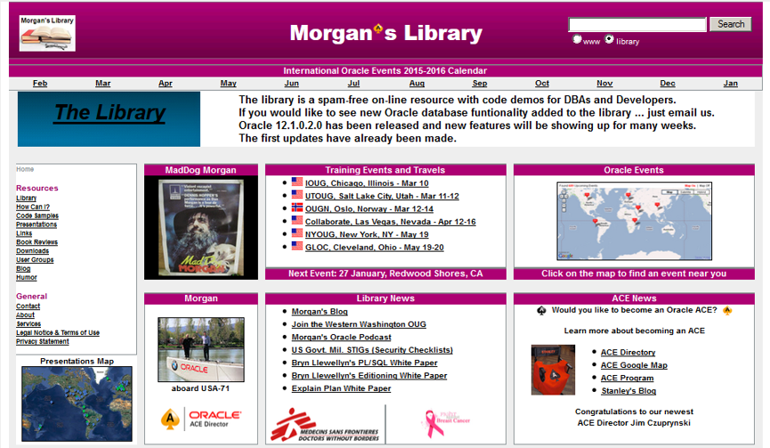
The Morgan's Library Web Site

Slide 5

Under the GoldenGate Bridge

Slide 6

To Watch Larry's AC72

Slide 7
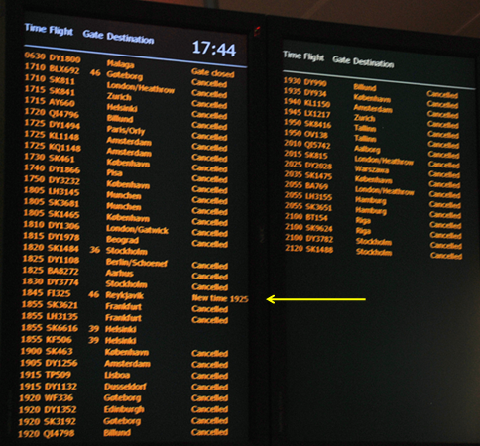
Travel Log: Thank You SAS

Slide 8

Travel Log: Greenland in April

Slide 9

Travel Log: With Jonathan Lewis & Tim Gorman in Beijing

Slide 10

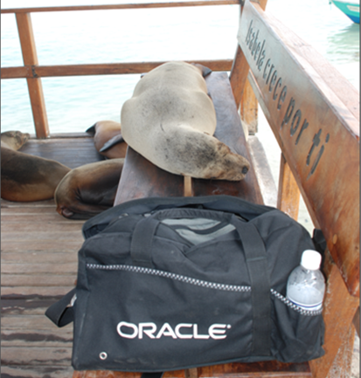
Travel Log: OTN LAD Tour 2014
The most important thing I discovered
during this trip is the how disruptive
our presence was to the locals.

Slide 11
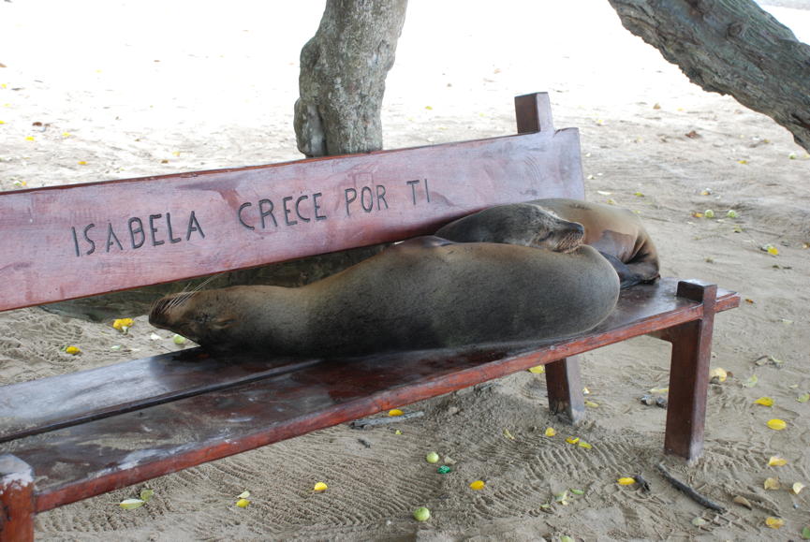
Travel Log: OTN LAD Tour 2014
The most important thing I discovered
during this trip is the how disruptive
our presence was to the locals.

Slide 12
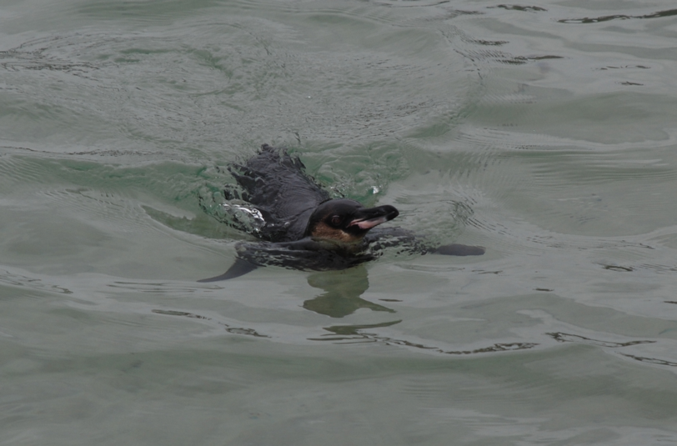
Travel Log: OTN LAD Tour 2014
The most important thing I discovered
during this trip is the how disruptive
our presence was to the locals.

Slide 13

IGGOUG: The New Users Group In The Neighborhood
www.iggoug.org

Slide 14

IGGOUG 2015 Conference

Slide 15
Disclaimer
This room is an unsafe harbour
No one from Oracle has previewed this presentation
No one from Oracle knows what I'm going to say
No one from Oracle has supplied any of my materials
This presentation includes examples of capabilities built into the Oracle database that Oracle has never promoted and that can have a substantial impact on database performance

Slide 16
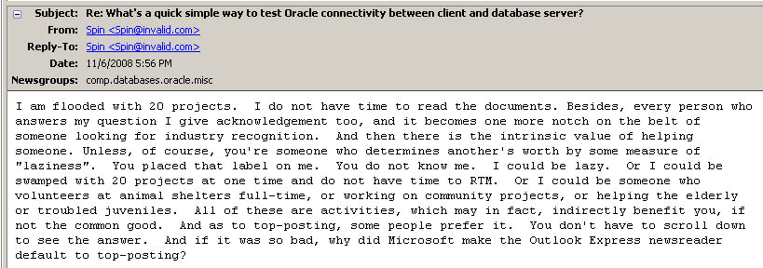
Fail
To be successful you MUST read the docs

Slide 17


Content Density Warning
Take Notes ... Ask Questions

Slide 18
Why Is An ACE Director Focusing On Insert Statements?
Because no one else is
Because Oracle University doesn't teach this material
Because there are 17 pages in the 12c docs on INSERT and it is incomplete
Because we have now spent more than 30 years talking about performance tuning and yet the number one conference and training topic is still "tuning" which proves that we need to stop focusing on edge cases and focus, instead, on the basics
Because explain plans, AWR Reports, and trace files will never fix a problem if you don't know the full range of options available
Because the best way to achieve high performance is to choose techniques that reduce resource utilization

Slide 19
Insert Statements

Slide 20
What Is SQL DML?
DML stands for Data Manipulation Language
DML is a direct reference to the following SQL statements
  INSERT
  UPDATE
  DELETE
  MERGE

Slide 21
SQL INSERT Statement Topics (1:2)
Basic Insert
INSERT WHEN
INSERT ALL
INSERT ALL WHEN
INSERT FIRST WHEN
INSERT INTO A SELECT STATEMENT
INSERT WITH CHECK OPTION
View Inserts
Editioning View Inserts
Partitioned Table Insert

Slide 22
SQL INSERT Statement Topics (2:2)
Tables with Virtual Columns Insert
Tables with Hidden Columns Insert
Create Table As Inserts
Nested Table Inserts
VARRAY Table Inserts
MERGE Statement Insert

Slide 23
PL/SQL INSERT Statement Topics
Record inserts
FORALL INSERTs
FORALL MERGE Inserts
LOB Inserts
DBMS_SQL Dynamic Inserts
Native Dynamic SQL Inserts
RETURNING Clause with a Sequence
RETURNING Clause with an Identity Column

Slide 24
Performance Tuning INSERT Statement Topics
Too Many Columns
Column Ordering
Aliasing and Fully Qualified Names
Implicit Casts
APPEND hint
APPEND_VALUES hint
DBMS_ERRLOG built-in package
  CHANGE_DUPKEY_ERROR_INDEX hint
  IGNORE_ON_DUPKEY_INDEX hint
DBMS_STATS
Insert Statement Most Common Error

Slide 25
SQL Insert Statements

Slide 26
Basic INSERT Statement (1:2)
Use this syntax to perform inserts into a single column in a heap, global temporary, IOT, or most partitioned tables
INSERT INTO <table_name>
(<column_name>)
VALUES
(<value>);
CREATE TABLE state (
state_abbrev VARCHAR2(2));
INSERT INTO state
(state_abbrev)
VALUES
('NY');
COMMIT;
SELECT * FROM state;

Slide 27
Basic INSERT Statement (2:2)
Use this syntax to perform inserts into multiple columns in a heap, global temporary, IOT, or most partitioned tables
INSERT INTO <table_name>
(<column_name>, <column_name> [,...])
VALUES
(<value>, <value> [,<value>]);
CREATE TABLE state (
state_abbrev VARCHAR2(2),
state_name VARCHAR2(30));
INSERT INTO state
(state_abbrev, state_name)
VALUES
('NY', 'New York');
COMMIT;
SELECT * FROM state;

Slide 28
INSERT WHEN
Use this syntax to conditionally insert rows into multiple tables
INSERT
WHEN (<condition>) THEN
INTO <table_name> (<column_list>)
VALUES (<values_list>)
WHEN (<condition>) THEN
INTO <table_name> (<column_list>)
VALUES (<values_list>)
ELSE
INTO <table_name> (<column_list>)
VALUES (<values_list>)
SELECT <column_list> FROM <table_name>;
INSERT
WHEN (deptno=10) THEN
INTO emp_10 (empno,ename,job,mgr,sal,deptno)
VALUES (empno,ename,job,mgr,sal,deptno)
WHEN (deptno=20) THEN
INTO emp_20 (empno,ename,job,mgr,sal,deptno)
VALUES (empno,ename,job,mgr,sal,deptno)
WHEN (deptno=30) THEN
INTO emp_30 (empno,ename,job,mgr,sal,deptno)
VALUES (empno,ename,job,mgr,sal,deptno)
ELSE
INTO leftover (empno,ename,job,mgr,sal,deptno)
VALUES (empno,ename,job,mgr,sal,deptno)
SELECT * FROM emp;

Slide 29
INSERT ALL
Use this syntax to unconditionally insert data into multiple tables
Note that some columns go into one table ... others into both
INSERT ALL
INTO <table_name> VALUES <column_name_list)
INTO <table_name> VALUES <column_name_list)
...
<SELECT Statement>;
INSERT ALL
INTO ap_cust VALUES (customer_id, program_id, delivered_date)
INTO ap_orders VALUES (order_date, program_id)
SELECT program_id, delivered_date, customer_id, order_date
FROM airplanes;

Slide 30
INSERT ALL WHEN
With "ALL", the default value, the database evaluates each WHEN sequentially
INSERT ALL
WHEN (<condition>) THEN
INTO <table_name> (<column_list>)
VALUES (<values_list>)
WHEN (<condition>) THEN
INTO <table_name> (<column_list>)
VALUES (<values_list>)
ELSE
INTO <table_name> (<column_list>)
VALUES (<values_list>)
SELECT <column_list> FROM <table_name>;
INSERT ALL
WHEN (deptno=10) THEN
INTO emp_10 (empno,ename,job,mgr,sal,deptno)
VALUES (empno,ename,job,mgr,sal,deptno)
WHEN (deptno=20) THEN
INTO emp_20 (empno,ename,job,mgr,sal,deptno)
VALUES (empno,ename,job,mgr,sal,deptno)
WHEN (deptno<=30) THEN
INTO emp_30 (empno,ename,job,mgr,sal,deptno)
VALUES (empno,ename,job,mgr,sal,deptno)
ELSE
INTO leftover (empno,ename,job,mgr,sal,deptno)
VALUES (empno,ename,job,mgr,sal,deptno)
SELECT * FROM emp;

Slide 31
INSERT FIRST WHEN
With FIRST the database evaluates each WHEN clause in the order in which it appears in the statement
INSERT FIRST
WHEN <condition> THEN
INTO <table_name> VALUES <column_name_list)
INTO <table_name> VALUES <column_name_list)
...
<SELECT Statement>;
INSERT FIRST
WHEN customer_id < 'I' THEN
INTO cust_ah
VALUES (customer_id, program_id, delivered_date)
WHEN customer_id < 'Q' THEN
INTO cust_ip
VALUES (customer_id, program_id, delivered_date)
WHEN customer_id > 'PZZZ' THEN
INTO cust_qz
VALUES (customer_id, program_id, delivered_date)
SELECT program_id, delivered_date, customer_id, order_date
FROM airplanes;

Slide 32
INSERT Into A SELECT Statement
Use this syntax to INSERT rows into one table as part of a SELECT statement from itself or a different table or tables
INSERT INTO <table_name> <SELECT Statement>;
CREATE TABLE state (
zip_code VARCHAR2(5) NOT NULL,
state_abbrev VARCHAR2(2) NOT NULL,
city_name VARCHAR2(30));
INSERT INTO (
SELECT postal_code, prov_abbrev, city
FROM dept)
VALUES (99, 'TRAVEL', 'SEATTLE');

Slide 33
INSERT with Check Option
Use this syntax to limit inserted rows to those that pass CHECK OPTION validation
INSERT INTO (
<SQL_statement> WITH CHECK OPTION)
VALUES
(value_list);
INSERT INTO (
SELECT deptno, dname, loc
FROM dept
WHERE deptno < 30 WITH CHECK OPTION)
VALUES (99, 'TRAVEL', 'SEATTLE');

Slide 34
INSERTing Into A View
Evaluate whether a view column is insertable
Views with aggregations, CONNECT BY, and other syntaxes may not be insertable
desc cdb_updatable_columns
SELECT cuc.con_id, cuc.owner, cuc.insertable, COUNT(*)
FROM cdb_updatable_columns cuc
WHERE (cuc.con_id, cuc.owner, cuc.table_name) IN
(SELECT cv.con_id, cv.owner, cv.view_name
FROM cdb_views cv)
GROUP BY cuc.con_id, cuc.owner, cuc.insertable
ORDER BY 1,2,3;
CON_ID OWNER INS COUNT(*)
---------- ------------------------- --- ----------
2 ORDSYS NO 4
2 ORDSYS YES 4
2 SYS NO 45190
2 SYS YES 22415
2 SYSTEM NO 172
2 SYSTEM YES 14
2 WMSYS NO 736
2 WMSYS YES 160

Slide 35
INSERTing Into An Editioning View
All editioning views are insertable ... but be sure you are in the correct edition
SQL> CREATE EDITION demo_ed;
SQL> CREATE OR REPLACE EDITIONING VIEW test AS
2 SELECT program_id, line_number
3 FROM airplanes;
View created.
SQL> ALTER SESSION SET EDITION=demo_ed;
Session altered.
SQL> CREATE OR REPLACE EDITIONING VIEW test AS
2 SELECT line_number, program_id
3 FROM airplanes;
View created.
SQL> SELECT * FROM user_editioning_views_ae;
VIEW_NAME TABLE_NAME EDITION_NAME
------------ ----------------------- -------------
TEST AIRPLANES ORA$BASE
TEST AIRPLANES DEMO_ED

Slide 36
INSERTing Into A Partitioned Table
With HASH, LIST, and RANGE partitioning any INSERT statement will work
With Partition by SYSTEM you must think more clearly
CREATE TABLE syst_part (
tx_id NUMBER(5),
begdate DATE)
PARTITION BY SYSTEM (
PARTITION p1,
PARTITION p2,
PARTITION p3);
INSERT INTO syst_part VALUES (1, SYSDATE-10);
*
ERROR at line 1:
ORA-14701: partition-extended name or bind variable must be used for DMLs on tables partitioned by the System method
INSERT INTO syst_part PARTITION (p1) VALUES (1, SYSDATE-10);
INSERT INTO syst_part PARTITION (p2) VALUES (2, SYSDATE);
INSERT INTO syst_part PARTITION (p3) VALUES (3, SYSDATE+10);
SELECT * FROM syst_part PARTITION(p2);

Slide 37
INSERTing Into Tables With Virtual Columns
Virtual columns will appear in a DESCRIBE statement but you cannot insert into them directly
CREATE TABLE vcol (
salary NUMBER(8),
bonus NUMBER(3),
total_comp NUMBER(10) AS (salary+bonus));
desc vcol
SELECT column_id, column_name, virtual_column
FROM user_tab_cols
WHERE table_name = 'VCOL'
INSERT INTO vcol
(salary, bonus, total_comp)
VALUES
(1,2,3);
INSERT INTO vcol
(salary, bonus)
VALUES
(1,2);
SELECT * FROM vcol;

Slide 38
INSERTing Into Tables With Invisible Columns
Invisible columns do not appear in a DESCRIBE statement but you can insert into them directly
CREATE TABLE vis (
rid NUMBER,
testcol VARCHAR2(20));
CREATE TABLE invis (
rid NUMBER,
testcol VARCHAR2(20) INVISIBLE);
desc vis
desc invis
SELECT table_name, column_name, hidden_column
FROM user_tab_cols -- not in user_tab_columns
WHERE table_name like '%VIS';
INSERT INTO invis
(rid, testcol)
VALUES
(1, 'TEST');
SELECT * FROM invis;
SELECT rid, testcol FROM invis;

Slide 39
CREATE TABLE AS INSERTS
Use this syntax to create a new table as the result of a SELECT statement
CREATE TABLE <table_name>
AS <SELECT Statement>;
CREATE TABLE column_subset AS
SELECT col1, col3, col5
FROM servers;
desc column_subset
SELECT COUNT(*)
FROM column_subset;

Slide 40
Nested Table Insert
Cast column values using the object column's data type
CREATE OR REPLACE NONEDITIONABLE TYPE CourseList AS TABLE OF VARCHAR2(64);
/
CREATE TABLE department (
name VARCHAR2(20),
director VARCHAR2(20),
office VARCHAR2(20),
courses CourseList)
NESTED TABLE courses STORE AS courses_tab;
INSERT INTO department
(name, director, office, courses)
VALUES
('English', 'Tara Havemeyer', 'Breakstone Hall 205', CourseList(
'Expository Writing',
'Film and Literature',
'Modern Science Fiction',
'Discursive Writing',
'Modern English Grammar',
'Introduction to Shakespeare',
'Modern Drama',
'The Short Story',
'The American Novel'));

Slide 41
VARRAY Table Insert
Cast column values using the VARRAY column's data type
CREATE OR REPLACE TYPE ProjectList AS VARRAY(50) OF Project;
/
CREATE TABLE department (
dept_id NUMBER(2),
dname VARCHAR2(15),
budget NUMBER(11,2),
projects ProjectList);
INSERT INTO department
VALUES(30, 'Accounting', 1205700,
ProjectList (Project(1, 'Design New Expense Report', 3250),
Project(2, 'Outsource Payroll', 12350),
Project(3, 'Evaluate Merger Proposal', 2750),
Project(4, 'Audit Accounts Payable', 1425)));

Slide 42
MERGE Statement Insert
Use MERGE statements where an insert or other DML is conditioned on the results of a SELECT statement
MERGE INTO bonuses b
USING (
SELECT employee_id, salary, dept_no
FROM employee
WHERE dept_no =20) e
ON (b.employee_id = e.employee_id)
WHEN MATCHED THEN
UPDATE SET b.bonus = e.salary * 0.1
DELETE WHERE (e.salary < 40000)
WHEN NOT MATCHED THEN
INSERT (b.employee_id, b.bonus)
VALUES (e.employee_id, e.salary * 0.05)
WHERE (e.salary > 40000);

Slide 43
PL/SQL Insert Statements

Slide 44
Record Insert
Use this syntax to insert based on an array that matches the target table rather than named individual columns
CREATE TABLE t AS
SELECT table_name, tablespace_name
FROM all_tables;
SELECT COUNT(*)
FROM t;
DECLARE
trec t%ROWTYPE;
BEGIN
trec.table_name := 'NEW';
trec.tablespace_name := 'NEW_TBSP';
INSERT INTO t
VALUES trec;
COMMIT;
END;
/
SELECT COUNT(*) FROM t;

Slide 45
FORALL INSERTs (1:3)
Use this syntax to greatly enhance performance but be sure you understand the concept of DIRECT LOAD INSERTs
With this syntax I can insert 500,000 rows per second on my laptop
Learn
  Limits Clause
  Save Exceptions
  Partial Collections
  Sparse Collections
  In Indices Of Clause
CREATE OR REPLACE PROCEDURE fast_way AUTHID CURRENT_USER IS
TYPE myarray IS TABLE OF parent%ROWTYPE;
l_data myarray;
CURSOR r IS
SELECT part_num, part_name
FROM parent;
BatchSize CONSTANT POSITIVE := 1000;
BEGIN
OPEN r;
LOOP
FETCH r BULK COLLECT INTO l_data LIMIT BatchSize;
FOR j IN 1 .. l_data.COUNT LOOP
l_data(j).part_num := l_data(j).part_num * 10;
END LOOP;
FORALL i IN 1..l_data.COUNT
INSERT INTO child VALUES l_data(i);
EXIT WHEN l_data.COUNT < BatchSize;
END LOOP;
COMMIT;
CLOSE r;
END fast_way;
/

Slide 46
FORALL INSERTs (2:3)
Use this syntax to greatly enhance performance but be sure you understand the concept of DIRECT LOAD INSERTs
With this syntax I can insert 500,000 rows per second on my laptop
Learn
  Limits Clause
  Save Exceptions
  Partial Collections
  Sparse Collections
  In Indices Of Clause
CREATE OR REPLACE PROCEDURE fast_way AUTHID CURRENT_USER IS
TYPE PartNum IS TABLE OF parent.part_num%TYPE
INDEX BY BINARY_INTEGER;
pnum_t PartNum;
TYPE PartName IS TABLE OF parent.part_name%TYPE
INDEX BY BINARY_INTEGER;
pnam_t PartName;
BEGIN
SELECT part_num, part_name
BULK COLLECT INTO pnum_t, pnam_t
FROM parent;
FOR i IN pnum_t.FIRST .. pnum_t.LAST LOOP
pnum_t(i) := pnum_t(i) * 10;
END LOOP;
FORALL i IN pnum_t.FIRST .. pnum_t.LAST
INSERT INTO child
(part_num, part_name)
VALUES
(pnum_t(i), pnam_t(i));
COMMIT;
END fast_way;
/

Slide 47
FORALL INSERTs (3:3)
Use this syntax to greatly enhance performance but be sure you understand the concept of DIRECT LOAD INSERTs
With this syntax I can insert 700,000+ rows per second on my laptop
Learn
  Limits Clause
  Save Exceptions
  Partial Collections
  Sparse Collections
  In Indices Of Clause
CREATE OR REPLACE PROCEDURE fast_way AUTHID CURRENT_USER IS
TYPE parent_rec IS RECORD (
part_num dbms_sql.number_table,
part_name dbms_sql.varchar2_table);
p_rec parent_rec;
CURSOR c IS
SELECT part_num, part_name FROM parent;
l_done BOOLEAN;
BEGIN
OPEN c;
LOOP
FETCH c BULK COLLECT INTO p_rec.part_num, p_rec.part_name
LIMIT 500;
l_done := c%NOTFOUND;
FOR i IN 1 .. p_rec.part_num.COUNT LOOP
p_rec.part_num(i) := p_rec.part_num(i) * 10;
END LOOP;
FORALL i IN 1 .. p_rec.part_num.COUNT
INSERT INTO child
(part_num, part_name)
VALUES
(p_rec.part_num(i), p_rec.part_name(i));
EXIT WHEN (l_done);
END LOOP;
COMMIT;
CLOSE c;
END fast_way;
/

Slide 48
FORALL MERGE Insert
Use this syntax to perform MERGE statements using array data
CREATE OR REPLACE PROCEDURE forall_merge AUTHID CURRENT_USER IS
TYPE ridVal IS TABLE OF forall_tgt.rid%TYPE
INDEX BY BINARY_INTEGER;
l_data ridVal;
BEGIN
SELECT rid BULK COLLECT INTO l_data
FROM forall_src;
FORALL i IN l_data.FIRST .. l_data.LAST
MERGE INTO forall_tgt ft
USING (
SELECT rid
FROM forall_src fs
WHERE fs.rid = l_data(i)) al
ON (al.rid = ft.rid)
WHEN MATCHED THEN
UPDATE SET upd = 'U'
WHEN NOT MATCHED THEN
INSERT (rid, ins, upd)
VALUES (l_data(i), 'I', NULL);
COMMIT;
END forall_merge;
/

Slide 49
LOB Inserts
When creating LOB objects be sure to use SecureFiles and be sure that you understand PCTVERSION, CHUNK, and other storage parameters
DECLARE
src_file BFILE;
dst_file BLOB;
lgh_file BINARY_INTEGER;
retval VARCHAR2(30);
BEGIN
src_file := bfilename('CTEMP', 'sphere.mpg');
INSERT INTO sct
(rid, bcol)
VALUES
(1, EMPTY_BLOB())
RETURNING bcol INTO dst_file;
SELECT bcol
INTO dst_file
FROM sct
WHERE rid = 1
FOR UPDATE;
dbms_lob.fileopen(src_file, dbms_lob.file_readonly);
lgh_file := dbms_lob.getlength(src_file);
dbms_lob.loadFromFile(dst_file, src_file, lgh_file);
UPDATE sct
SET bcol = dst_file
WHERE rid = 1;
dbms_lob.setContentType(dst_file, 'MPG Movie');
retval := dbms_lob.getContentType(dst_file);
dbms_output.put_line(retval);
dbms_lob.fileclose(src_file);
END load_file;
/

Slide 50
Dynamic Insert with DBMS_SQL
DBMS_SQL is the legacy implementation of dynamic SQL in the Oracle database introduced in version 7.3.4.
CREATE OR REPLACE PROCEDURE single_row_insert(c1 NUMBER, c2 NUMBER, r OUT NUMBER) IS
c NUMBER;
n NUMBER;
BEGIN
c := dbms_sql.open_cursor;
dbms_sql.parse(c, 'INSERT INTO tab VALUES (:bnd1, :bnd2) ' ||
'RETURNING c1*c2 into :bnd3', 2);
dbms_sql.bind_variable(c, 'bnd1', c1);
dbms_sql.bind_variable(c, 'bnd2', c2);
dbms_sql.bind_variable(c, 'bnd3', r);
n := dbms_sql.execute(c);
dbms_sql.variable_value(c, 'bnd3', r); -- get value of outbind
dbms_sql.close_cursor(c);
END single_row_insert;
/

Slide 51
Dynamic Insert with Native Dynamic SQL
Native Dynamic SQL has largely replaced DBMS_SQL as it is robust and more easily coded
BEGIN
FOR i IN 1 .. 10000
LOOP
EXECUTE IMMEDIATE 'INSERT INTO t VALUES (:x)'
USING i;
END LOOP;
END;
/

Slide 52
RETURNING Clause with a Sequence
Use this syntax to return values from an insert statement unknown to the program inserting the row
INSERT INTO <table_name>
(column_list)
VALUES
(values_list)
RETURNING <value_name>
INTO <variable_name>;
DECLARE
x emp.empno%TYPE;
r rowid;
BEGIN
INSERT INTO emp
(empno, ename)
VALUES
(seq_emp.NEXTVAL, 'Morgan')
RETURNING rowid, empno
INTO r, x;
dbms_output.put_line(r);
dbms_output.put_line(x);
END;
/

Slide 53
RETURNING Clause with an Identify Column
Use this syntax to return values from an insert statement unknown to the program inserting the row
CREATE TABLE idcoltab (
rec_id NUMBER GENERATED ALWAYS AS IDENTITY,
coltxt VARCHAR2(30));
DECLARE
rid idcoltab.rec_id%TYPE;
BEGIN
INSERT INTO idcoltab
(coltxt)
VALUES
('Morgan')
RETURNING rec_id
INTO rid;
dbms_output.put_line(rid);
END;
/

Slide 54
Performance Tuning Insert Statements

Slide 55
Too Many Columns (1:2)
Oracle claims that a table can contain up to 1,000 columns: It is not true
The maximum number of real table columns is 255
Break the 255 barrier and optimizations such as advanced and hybrid columnar compression no longer work
A 1,000 column table is actually four tables joined together seamlessly behind the scenes just as a partitioned table appears to be a single segment but isn't
Be suspicious of any table with more than 50 columns. At 100 columns it is time to reread the Codd-Date rules on normalization
Think vertically not horizontally

Slide 56
Too Many Columns (2:2)
Be very suspicious of any table with column names in the form "SPARE1", "SPARE2"
The more columns a table has the more cpu is required when accessing columns to the right (as the table is displayed in a SELECT * query)

Slide 57
Column Ordering (1:4)
Computers are not humans and tables are not paper forms
CBO's column retrieval cost
  Oracle stores columns in variable length format
  Each row is parsed in order to retrieve one or more columns
  Each subsequently parsed column introduces a cost of 20 cpu cycles regardless of whether it is of value or not

Slide 58
Column Ordering (2:4)
These tables will be accessed by person_id or state: No one will ever put the address2 column into the WHERE clause as a filter
CREATE TABLE customers (
person_id NUMBER,
first_name VARCHAR2(30) NOT NULL,
middle_init VARCHAR2(2),
last_name VARCHAR2(30) NOT NULL,
address1 VARCHAR2(30),
address2 VARCHAR2(30),
city VARCHAR2(30),
state VARCHAR2(2));
CREATE TABLE customers (
person_id NUMBER,
last_name VARCHAR2(30) NOT NULL,
state VARCHAR2(2) NOT NULL,
city VARCHAR2(30) NOT NULL,
first_name VARCHAR2(30) NOT NULL,
address1 VARCHAR2(30),
address2 VARCHAR2(30),
middle_init VARCHAR2(2));

Slide 59
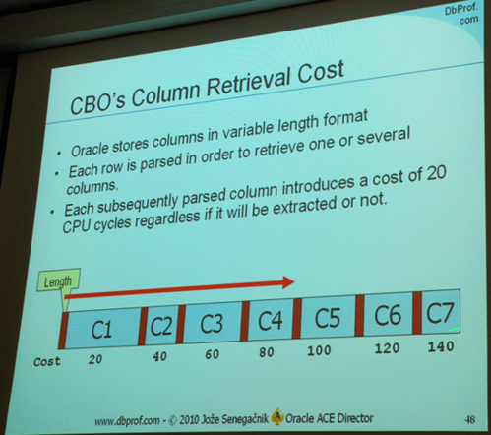
Column Ordering (3:4)
Oracle stores columns in variable length format
Each column parsed , whether used, has a cost of 20 cpu cycles

Slide 60
Column Ordering (4:4)
Proof column order matters
CREATE TABLE read_test AS
SELECT *
FROM apex_040200.wwv_flow_page_plugs
WHERE rownum = 1;
SQL> explain plan for
2 select * from read_test;
PLAN_TABLE_OUTPUT
-------------------------------------------------------------------------------
| Id | Operation | Name | Rows | Bytes | Cost (%CPU)| Time |
-------------------------------------------------------------------------------
| 0 | SELECT STATEMENT | | 1 | 214K| 2 (0)| 00:00:01 |
| 1 | TABLE ACCESS FULL| READ_TEST | 1 | 214K| 2 (0)| 00:00:01 |
-------------------------------------------------------------------------------
-- fetch value from column 1
Final cost for query block SEL$1 (#0) - All Rows Plan:
Best join order: 1
Cost: 2.0002 Degree: 1 Card: 1.0000 Bytes: 13
Resc: 2.0002 Resc_io: 2.0000 Resc_cpu: 7271
Resp: 2.0002 Resp_io: 2.0000 Resc_cpu: 7271
-- fetch value from column 193
Final cost for query block SEL$1 (#0) - All Rows Plan:
Best join order: 1
Cost: 2.0003 Degree: 1 Card: 1.0000 Bytes: 2002
Resc: 2.0003 Resc_io: 2.0000 Resc_cpu: 11111
Resp: 2.0003 Resp_io: 2.0000 Resc_cpu: 11111

Slide 61
Aliasing and Fully Qualified Names
When you do not use fully qualified names Oracle must do the work for you
You write code once ... the database executes it many times
SELECT DISTINCT s.srvr_id
FROM servers s, serv_inst i
WHERE s.srvr_id = i.srvr_id;
SELECT DISTINCT s.srvr_id
FROM uwclass.servers s, uwclass.serv_inst i
WHERE s.srvr_id = i.srvr_id;

Slide 62
Implicit Casts
Code that does not correctly define data types will either fail to run or run very inefficiently
The following example shows both the correct way and the incorrect way to work with dates. The correct way is to perform an explicit cast
SQL> create table t (
2 datecol date);
Table created.
SQL> insert into t values ('01-JAN-2015');
1 row created.
SQL> insert into t values (TO_DATE('01-JAN-2015'));
1 row created.

Slide 63
Hint Warning
The best advice on hinting I have ever read
Rules for Hinting
Don't
If you must use hints, then assume you've used them incorrectly.
On every patch or upgrade to Oracle, assume every piece of hinted SQL is going to do the wrong thing. Because of (2) above; you've been lucky so far, but the patch/upgrade lets you discover your mistake.
Every time you apply some DDL to an object that appears in a piece of hinted SQL assume that the hinted SQL is going to do the wrong thing. Because of (2) above; you've been lucky so far, but the structural change lets you discover your mistake.
Jonathan Lewis

Slide 64
APPEND Hint
The APPEND hint enables direct-path INSERT if the database is running in serial mode. The database is in serial mode if you are not using Enterprise Edition. Conventional INSERT is the default in serial mode, and direct-path INSERT is the default in parallel mode
In direct-path INSERT data is appended above the high-water mark potentially improving performance
INSERT /*+ APPEND */ INTO t
SELECT * FROM servers;

Slide 65
APPEND_VALUES Hint (1:2)
Use this new 12c hint instructs the optimizer to use direct-path INSERT with the VALUES clause
If you do not specify this hint, then conventional INSERT is used
This hint is only supported with the VALUES clause of the INSERT statement
If you specify it with an insert that uses the subquery syntax it is ignored

Slide 66
APPEND_VALUES Hint (2:2)
SQL> EXPLAIN PLAN FOR
2 INSERT INTO t
3 VALUES
4 ('XYZ');
SQL> SELECT * FROM TABLE(dbms_xplan.display);
---------------------------------------------------------------------------------
| Id | Operation | Name | Rows | Bytes | Cost (%CPU)| Time |
---------------------------------------------------------------------------------
| 0 | INSERT STATEMENT | | 1 | 100 | 1 (0)| 00:00:01 |
| 1 | LOAD TABLE CONVENTIONAL | T | | | | |
---------------------------------------------------------------------------------
SQL> EXPLAIN PLAN FOR
2 INSERT /*+ APPEND_VALUES */ INTO t
3 VALUES
4 ('XYZ');
SQL> SELECT * FROM TABLE(dbms_xplan.display);
-------------------------------------------------------------------------
| Id | Operation | Name | Rows | Bytes | Cost (%CPU)| Time |
-------------------------------------------------------------------------
| 0 | INSERT STATEMENT | | 1 | 100 | 1 (0)| 00:00:01 |
| 1 | LOAD AS SELECT | T | | | | |
| 2 | BULK BINDS GET | | | | | |
-------------------------------------------------------------------------

Slide 67
DBMS_ERRLOG (1:2)
Provides a procedure that enables creating an error logging table so that DML operations can continue after encountering errors rather than performing an abort and rollback
Tables with LONG, CLOB, BLOB, BFILE, and ADT data types are not supported
LOG ERRORS effectively it turns
array processing into single row
processing, so it adds an
expense at the moment of
inserting, even though it saves
you the overhead of an array
rollback if a duplicate gets
into the data (Jonathan Lewis)
CREATE TABLE t AS
SELECT *
FROM all_tables
WHERE 1=2;
ALTER TABLE t
ADD CONSTRAINT pk_t
PRIMARY KEY (owner, table_name)
USING INDEX;
ALTER TABLE t
ADD CONSTRAINT cc_t
CHECK (blocks < 11);
INSERT /*+ APPEND */ INTO t
SELECT *
FROM all_tables;

Slide 68
DBMS_ERRLOG (2:2)
exec dbms_errlog.create_error_log('T');
desc err$_t
INSERT /*+ APPEND */ INTO t
SELECT *
FROM all_tables
LOG ERRORS
REJECT LIMIT UNLIMITED;
SELECT COUNT(*) FROM t;
COMMIT;
SELECT COUNT(*) FROM t;
SELECT COUNT(*) FROM err$_t;
set linesize 121
col table_name format a30
col blocks format a7
col ora_err_mesg$ format a60
SELECT ora_err_mesg$, table_name, blocks
FROM err$_t;

Slide 69
  CHANGE_DUPKEY_ERROR_INDEX hint
Use this hint to unambiguously identify a unique key violation for a specified set of columns or for a specified index
When a unique key violation occurs for the specified index, an ORA-38911 error is reported instead of an ORA-00001
INSERT /*+ CHANGE_DUPKEY_ERROR_INDEX(T,TESTCOL) */ INTO t (testcol)
VALUES
('A');

Slide 70
IGNORE_ON_DUPKEY_INDEX hint
This hint applies only to single-table INSERT operations
It causes the statement to ignore a unique key violation for a specified set of columns or for a specified index
When a unique key violation is encountered, a row-level rollback occurs and execution resumes with the next input row
If you specify this hint when inserting data with DML error logging enabled, then the unique key violation is not logged and does not cause statement termination
INSERT /*+ IGNORE_ROW_ON_DUPKEY_INDEX(T,UC_T_TESTCOL)) */ INTO t
(testcol)
VALUES
(1);

Slide 71
DBMS_STATS ??
System Stats
Fixed Object Stats
Dictionary Stats
Set stats for new partitions so that when inserts take place the optimizer knows what you are inserting
exec dbms_stats.set_table_stats(USER, 'EMP', numrows=>1000000, numblks=>10000, avgrlen=>74);
exec dbms_stats.set_index_stats(USER, 'ix_emp_deptno', numrows=>1000000, numlblks=>1000,
numdist=>10000, clstfct=>1);
exec dbms_stats.set_column_stats(USER, 'emp', 'deptno', distcnt=>10000);
exec dbms_stats.set_table_stats(USER, 'dept', numrows=>100, numblks=>100);

Slide 72
INSERT Statement Most Common Error
If you do not name columns DDL can break your insert statement and not doing so will use a less efficient code path
If you do not name columns you for the database to do your work for you ... thousands or millions of times
INSERT INTO <table_name>
(<comma_separated_column_name_list>)
VALUES
(<comma_separated_value_list>);
CREATE TABLE state (
state_abbrev VARCHAR2(2),
state_name VARCHAR2(30),
city_name VARCHAR2(30));
INSERT INTO state
(state_abbrev, state_name)
VALUES
('NY', 'New York');
INSERT INTO state
VALUES
('NY', 'New York');

Slide 73
Wrap Up

Slide 74
Conclusions
How comfortable are you with your knowledge of UPDATE and DELETE statements?
How comfortable are you with your knowledge of SELECT statements?
Based on my experience no one should be
The most important principle in INSERT statements, and everything else in Oracle is "do the least work"
  Minimize CPU utilization
  Minimize I/O
  Minimize network utilization
    Bandwidth
    Round Trips
  Minimize your memory footprint
  An optimized balance is what leads to high performance

Slide 75

Thank you
ERROR at line 1:
ORA-00028: your session has been killed
Feel free to ask questions now or contact me at PTC
daniel.morgan@perftuning.com / +1 206-669-2949
Skype: damorgan11g

